Slide 1


Slide 2
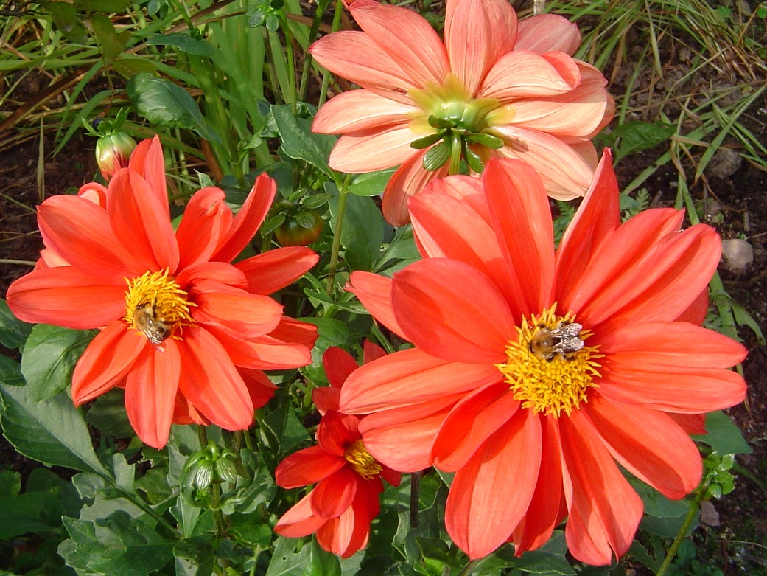
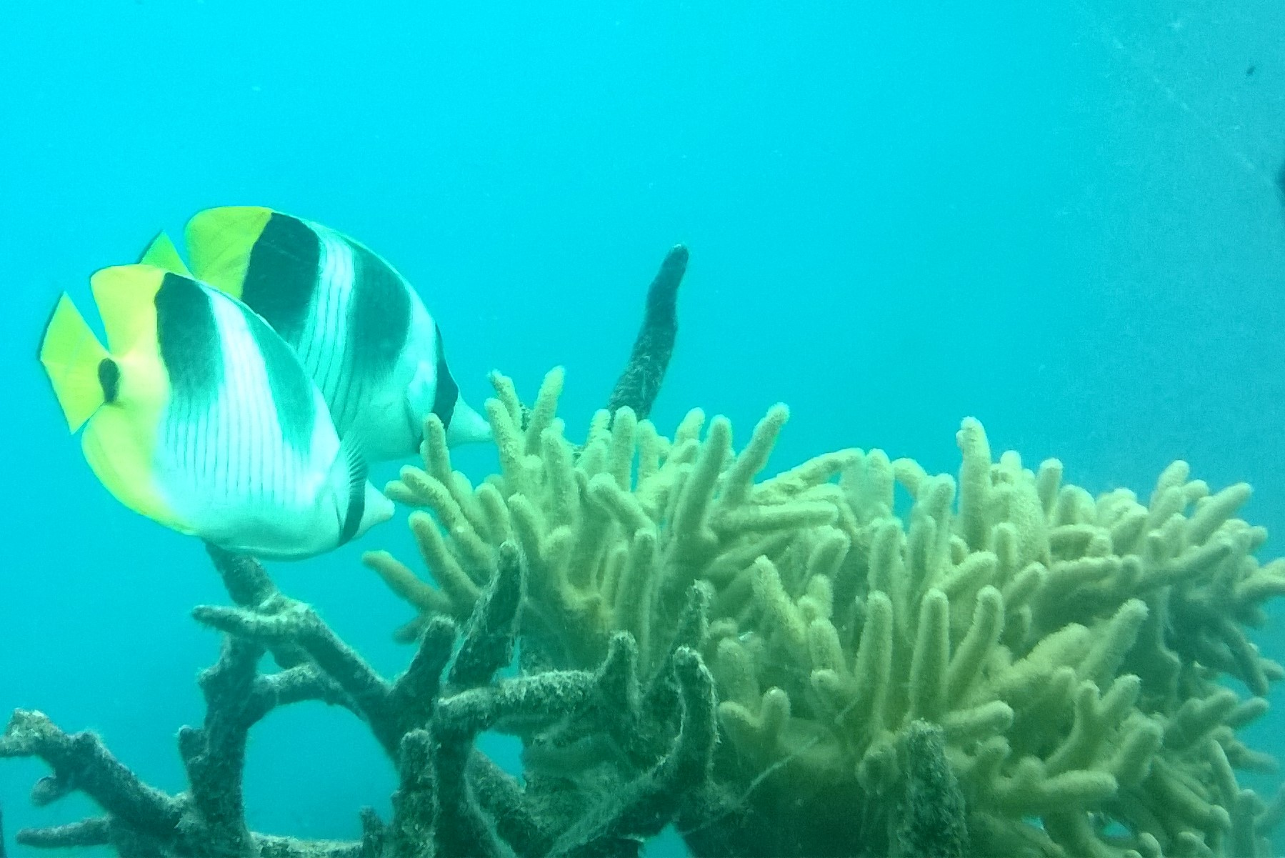
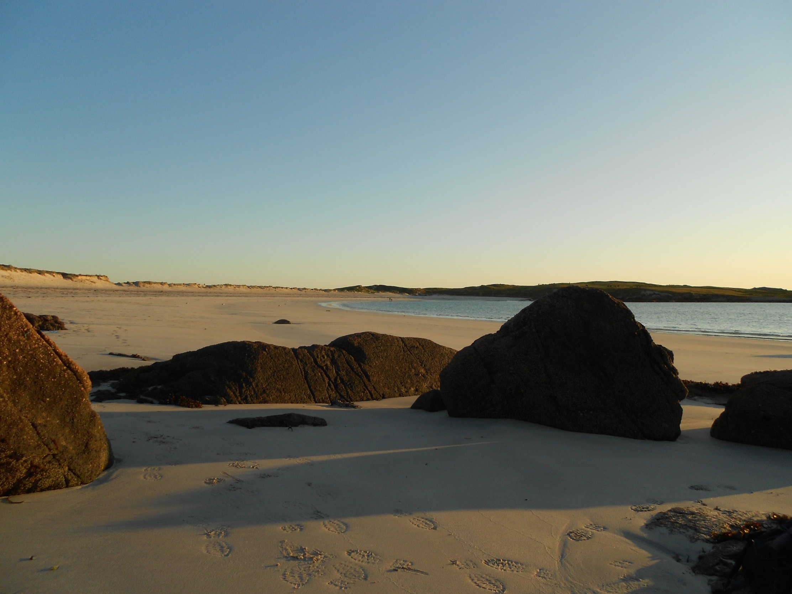

Slide 3
Praise
Psalm 148
All creatures are called to praise God
  Beginning with the heavenly bodies
  Then earthly creatures
  Then humans
A vast cosmic choir constantly engaged in the praise of God

Slide 4
Environmental change has always happened
In biblical times
In geological times

Slide 5
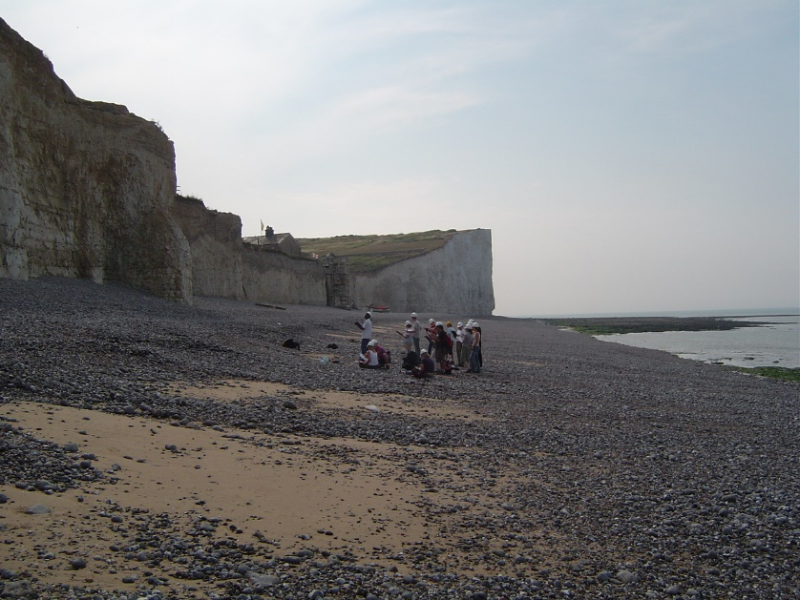
Chalk: Mid-Cretaceous (94 million years ago)
High global temperatures.
No ice caps.
Sea levels 200m higher.
Notes:
Dinosaurs dominant.

Slide 6
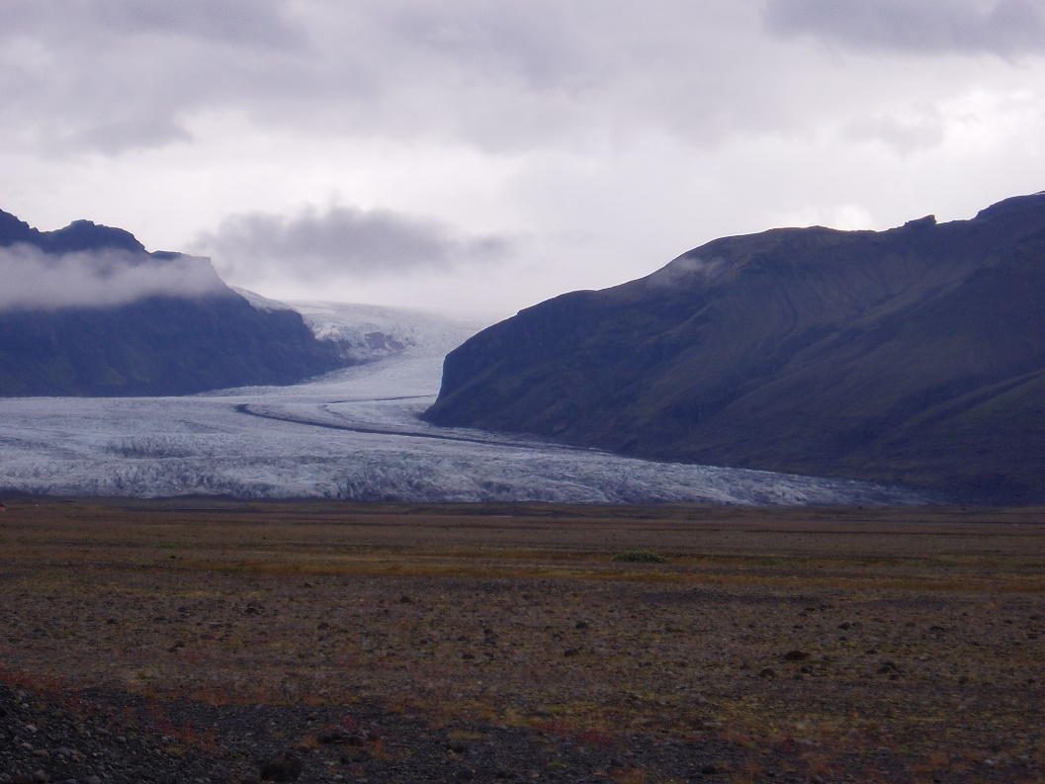
Over the past 750,000 years of Earth's history, Ice Ages have occurred at regular intervals, of approximately 100,000 years each.
The last Ice Age ended about 12,000 years ago.
Picture: Southern Iceland 21st Century.
Wales, 12,000 years ago?

Slide 7
Environmental change has always happened – but its suddenly happening much faster
Due to the profound effect man is having on the environment, we are now entering the so-called Anthropocene!
August 2017 was the second warmest August in 137 years of modern global record-keeping
Notes:
No ice in the Cretaceous. Much hotter. Continuous ocean round the equator 200m higher sea levels over a period of 70m years.
2016 was the hottest since records began.

Slide 8
Carbon Dioxide level measured at Mauna Loa Observatory, Hawaii
When I started teaching (1973): 333 ppm
Current: 403 ppm (24th September 2017)
Record: 412.6 ppm (26th April 2017)
  = 24% rise in 44 years

Slide 9
Environmental change has always happened – but its suddenly happening much faster
Since 1970:
Wildlife populations have declined by 52%
Land-based populations have dropped by 39%
Aquatic populations have dropped by 76%
The biggest declines have been in the tropics
The Living Planet Report 2014

Slide 10
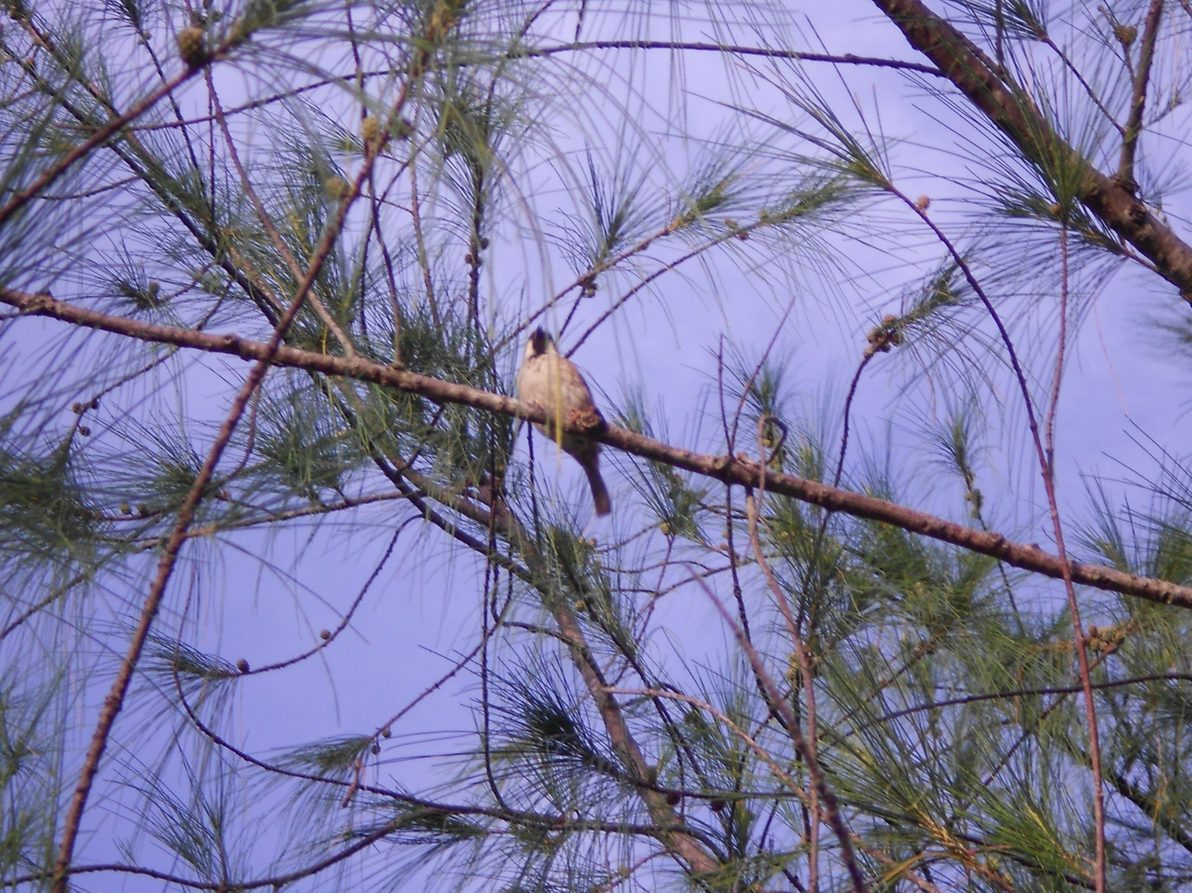
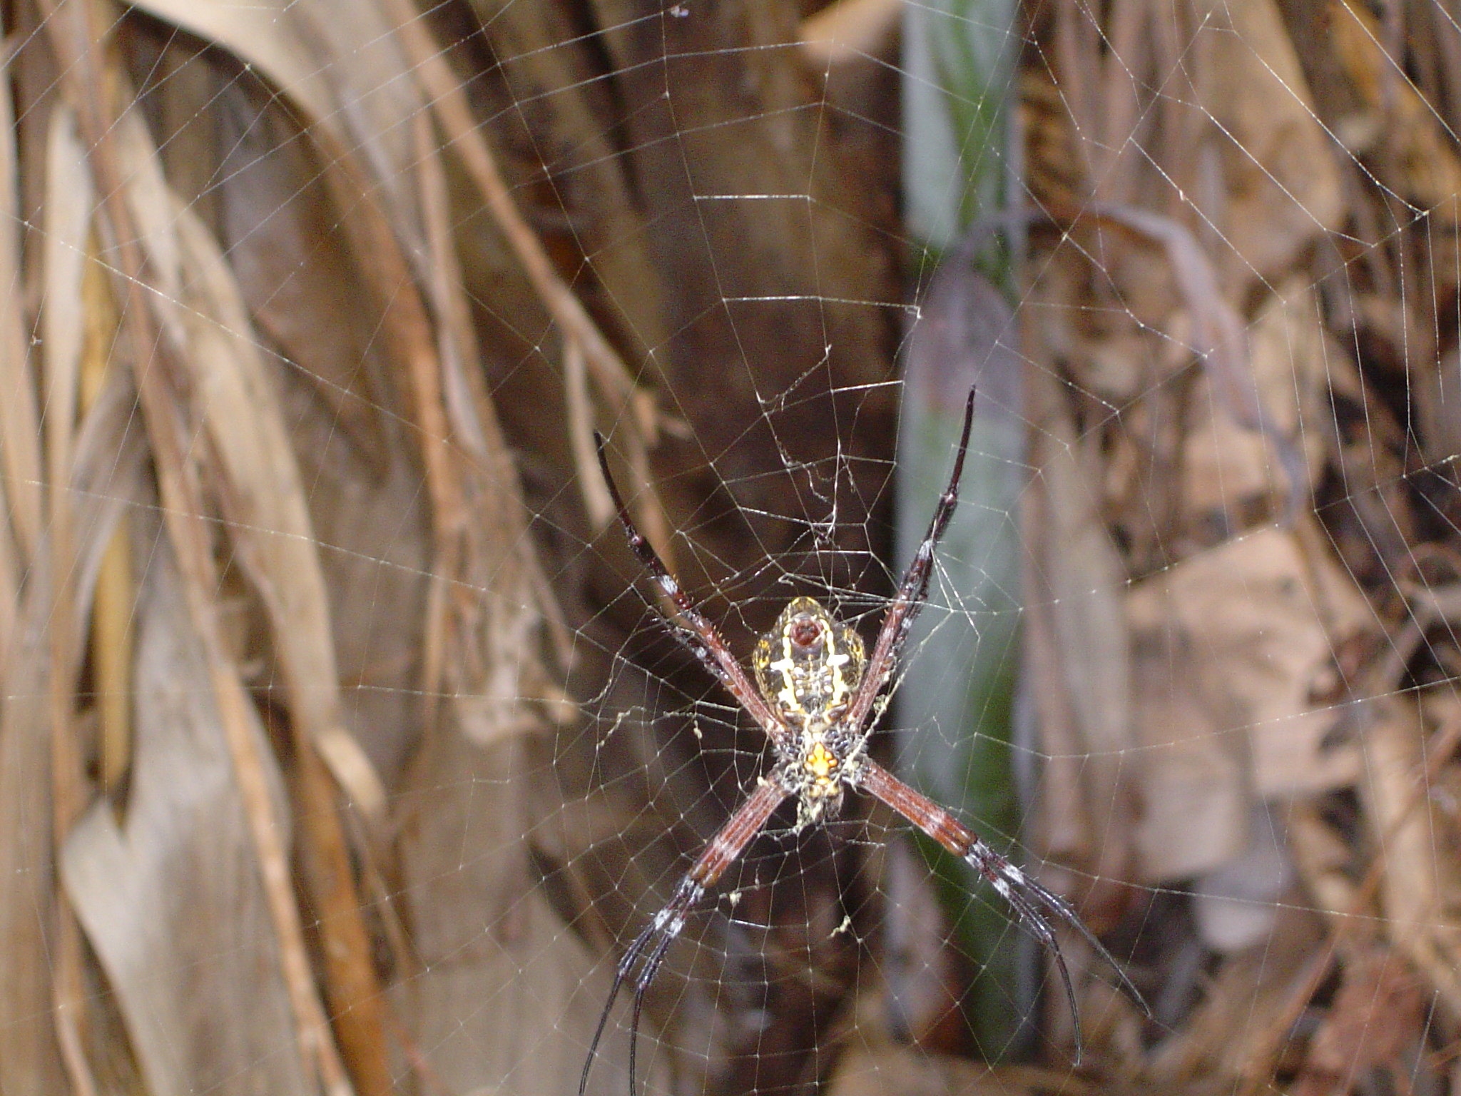
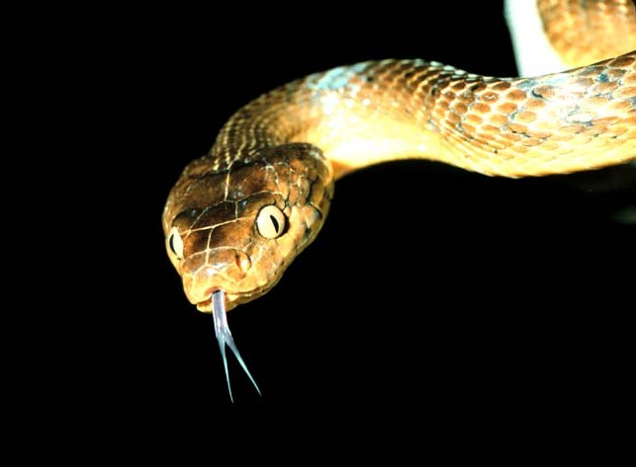
Guam tree snake:
Public Domain, https://commons.wikimedia.org/w/index.php?curid=2810297
5 cm
Notes:
Mature female Guam banana spider Argiope appensa. Population 40x larger in rainy season than neighbouring snake-free islands. Snake Boiga irregularis

Slide 11
Pope Francis: Laudato si (2015)
“The violence in our hearts, wounded by sin, is also reflected in the symptoms of sickness evident in the soil, in the water, in the air and in all forms of life.”

Slide 12
All things!
Paul writes , through Christ, “God was pleased to reconcile to himself all things, whether on earth or in heaven, making peace by the blood of his cross.”*
Reconciliation not just between God and man or between man and man, but with all creation!
* Colossians 1: 20

Slide 13


Christ helps us see God;
First-born Son creates all things
Things seen or unseen
Christ, head of the church
Reconciling ev’rything;
Peace made on his cross
Godfrey Armitage, 2015
Notes:
Haiku by GNA

Slide 14
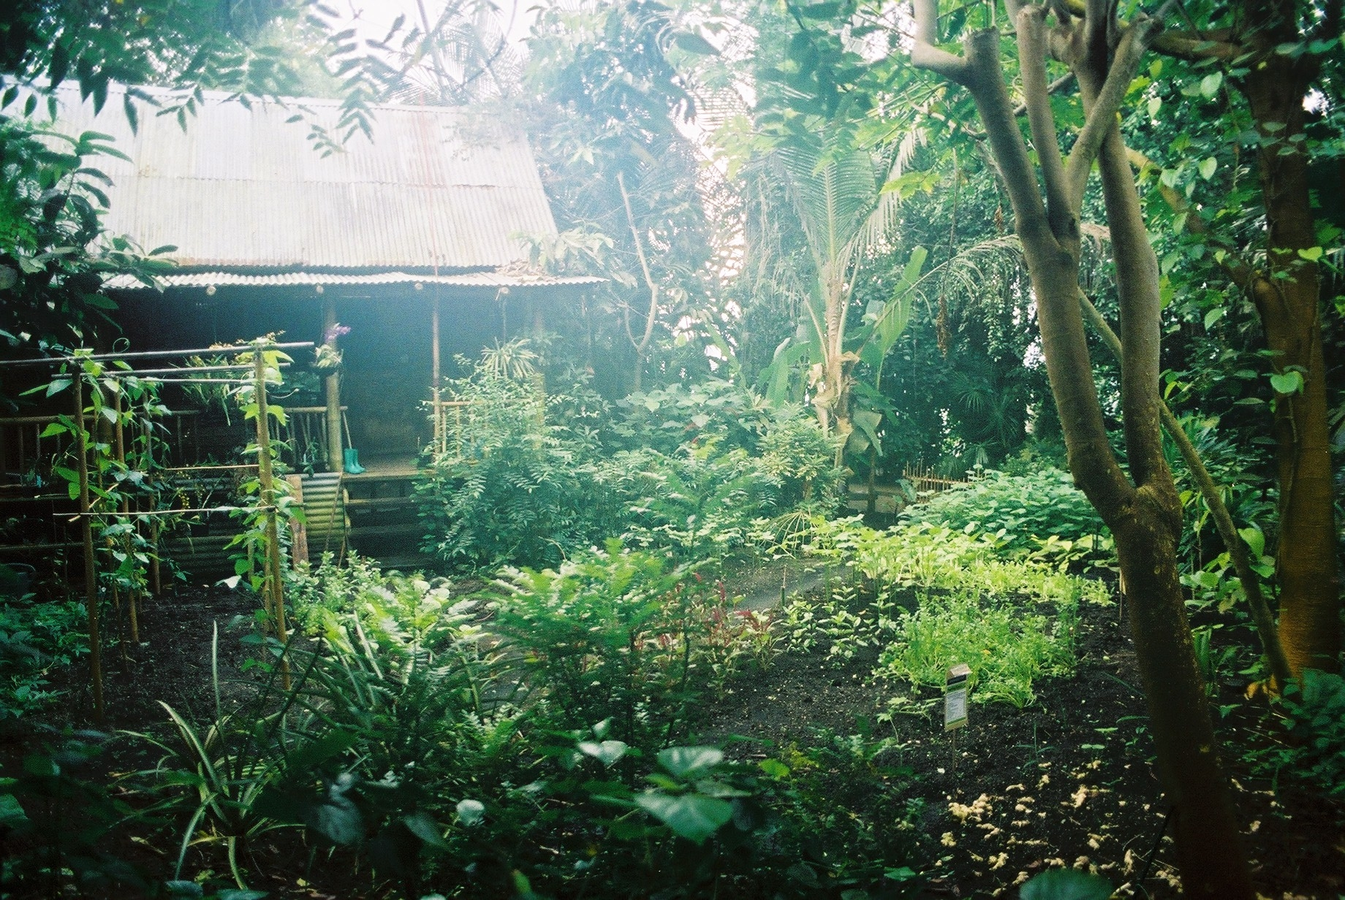
The gardener of Eden
God delights in his creation. So should we. Mary mistook the risen Jesus: thinking him to be the
gardener.
The Master gardener of creation!
Can we be identified with this new gardener, equipped to till the soil where Adam failed?
So care for God’s creation is not an option or a hobby for Christians, but an integral part of the gospel

Slide 16
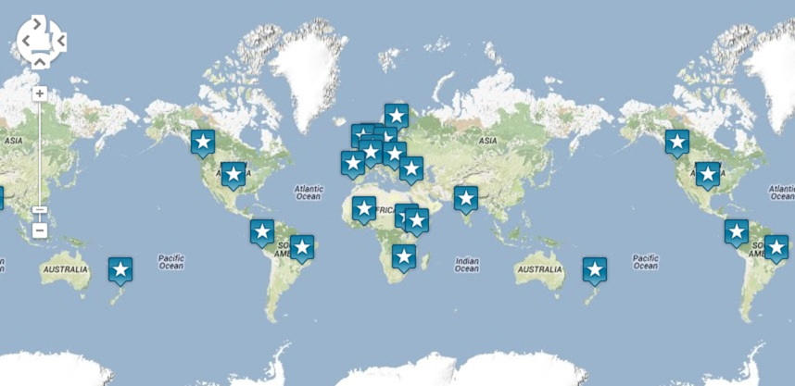
A Rocha opened a nature reserve in Portugal in 1986 and now works in twenty countries

Slide 17

Our Values
Christian
Conservation
Community
Cross-cultural
Cooperation

Slide 18

A Rocha UK :
Mobilising Christians and the Churches to care for the natural world
(For God, nature and everyone)

Slide 19

The big picture
The planet’s in danger

Slide 20
The big picture
The planet’s in danger
There are things we can do about it

Slide 21
The big picture
The planet’s in danger
There are things we can do about it
We need to get working

Slide 22
The big picture
The planet’s in danger
There are things we can do about it
We need to get working
We need to get others inspired to act

Slide 23
The big picture
The planet’s in danger
There are things we can do about it
We need to get working
We need to get others inspired to act
We may need serious changes in lifestyle

Slide 24
What can Christians do?
Mobilise Churches and Christians to act

Slide 25
What can Christians do?
Mobilise Churches and Christians to act
Where they can make the biggest difference

Slide 26
What can Christians do?
Mobilise Churches and Christians to act
Where they can make the biggest difference
To multiply our collective impact

Slide 27
What can Christians do?
Mobilise Churches and Christians to act
Where they can make the biggest difference
To multiply our collective impact
For nature in UK and beyond

Slide 28
A Rocha action
A Rocha reserves - for integrity and demonstration of community conservation and local impact
Churches – Eco Church
Christian individuals and families – Living Lightly
Christian Land Managers – Partners in Action

Slide 29
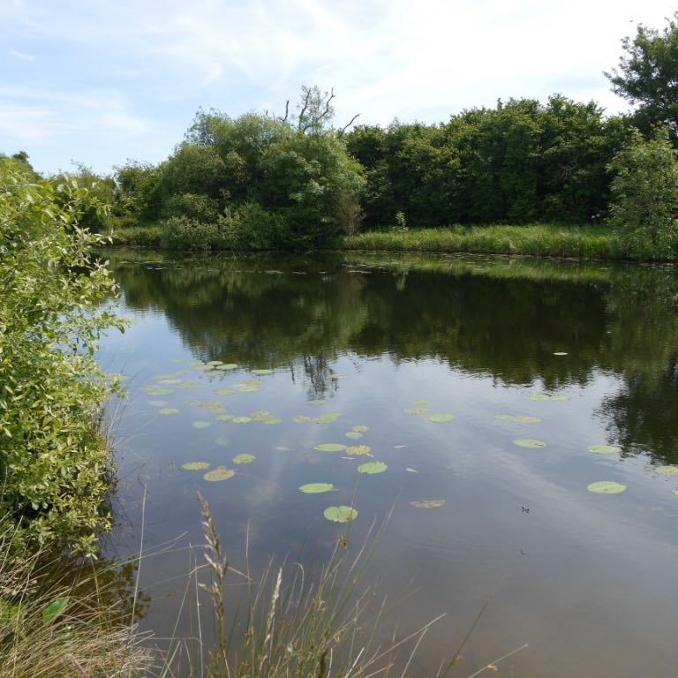

Slide 30
A Rocha reserves
Foxearth Meadows Nature Reserve
opened 13th May 2017 (A Rocha UK)

Slide 31






and others
Launched at St Paul’s Cathedral on 26 January 2016

Slide 32


An on-line survey which allows you to assess and improve your church’s environmental impact

Slide 33
Eco Survey
Worship and teaching
Management of church buildings
Management of church land
Community and global engagement
Lifestyle

Slide 34
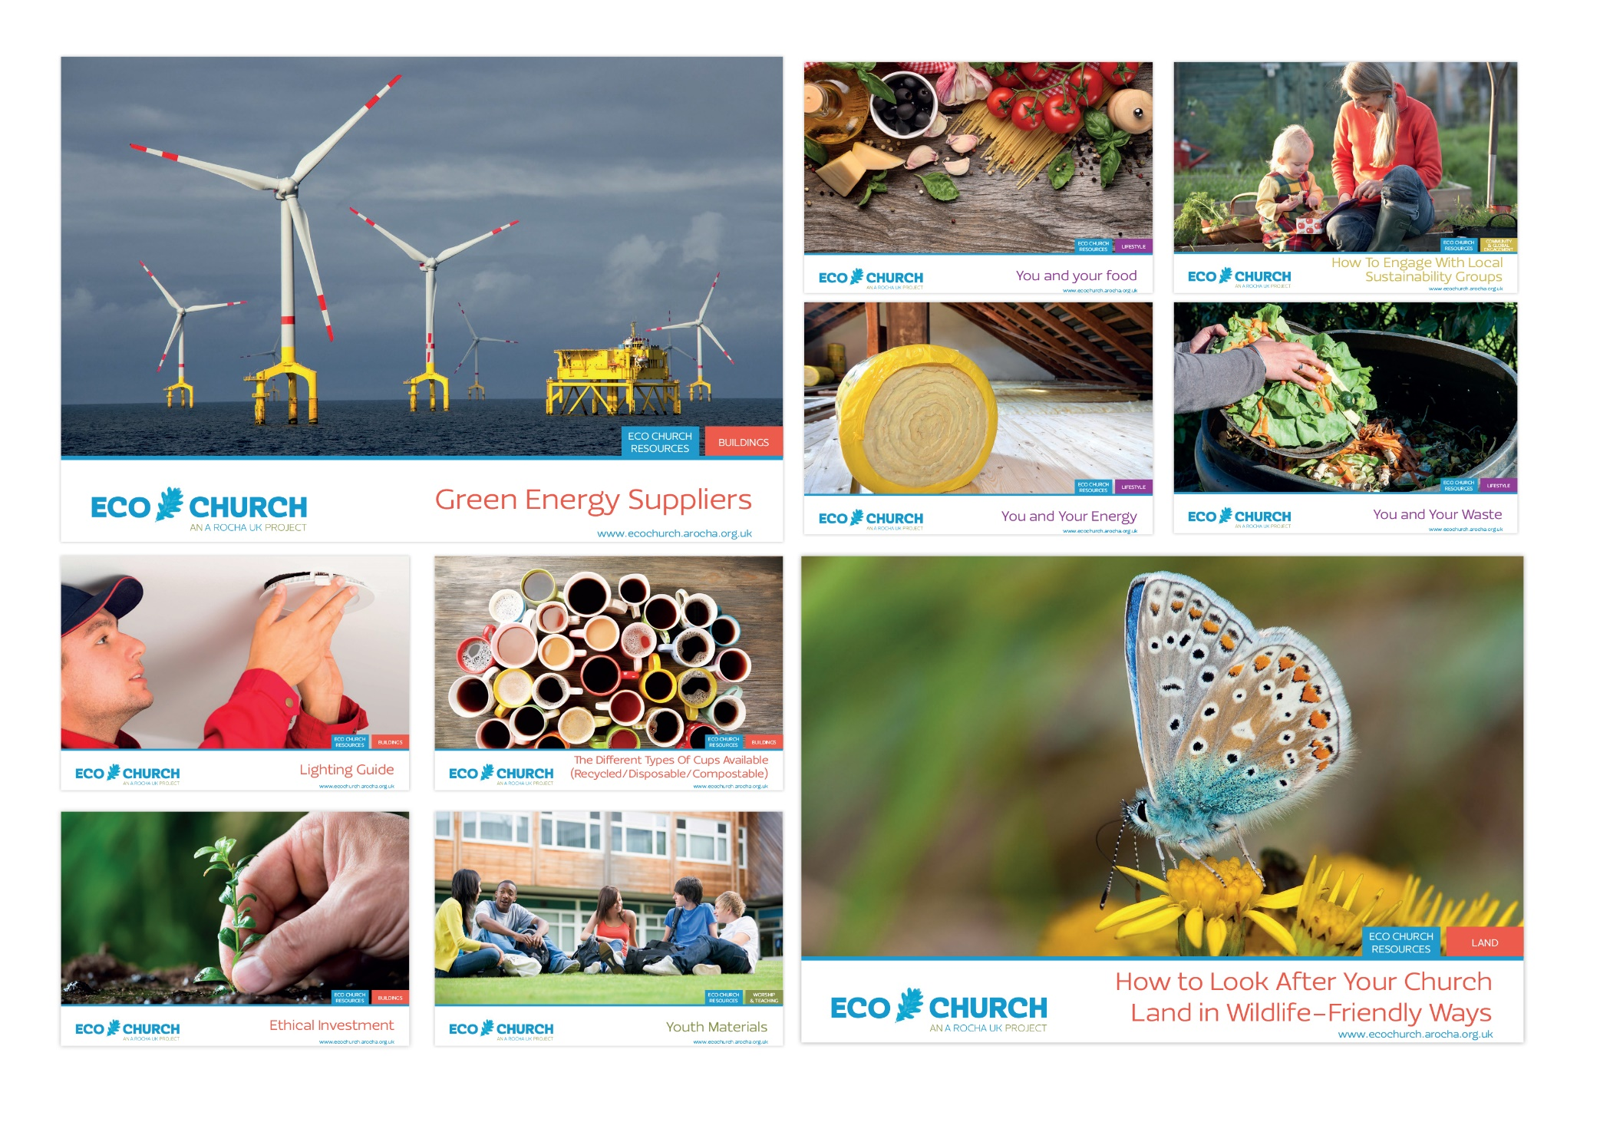

Slide 35
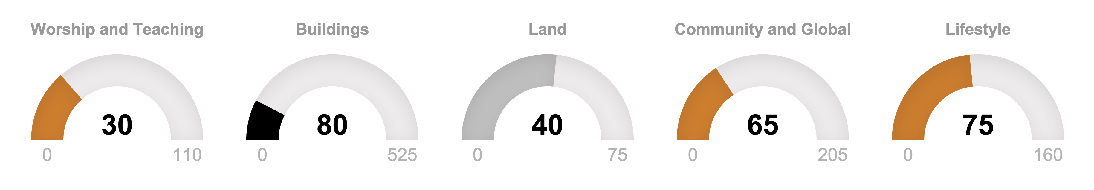
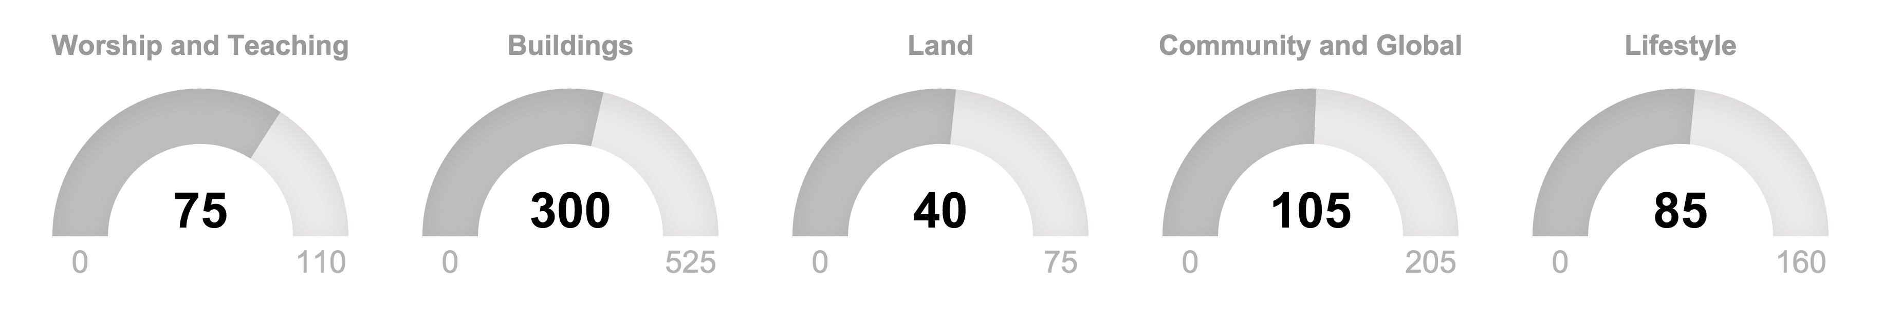
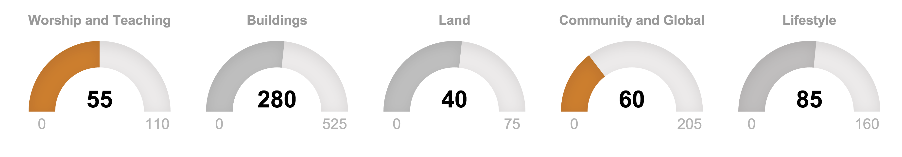
Eco Church Award Points
Work on those buildings!
Silver!
Bronze!

Slide 36
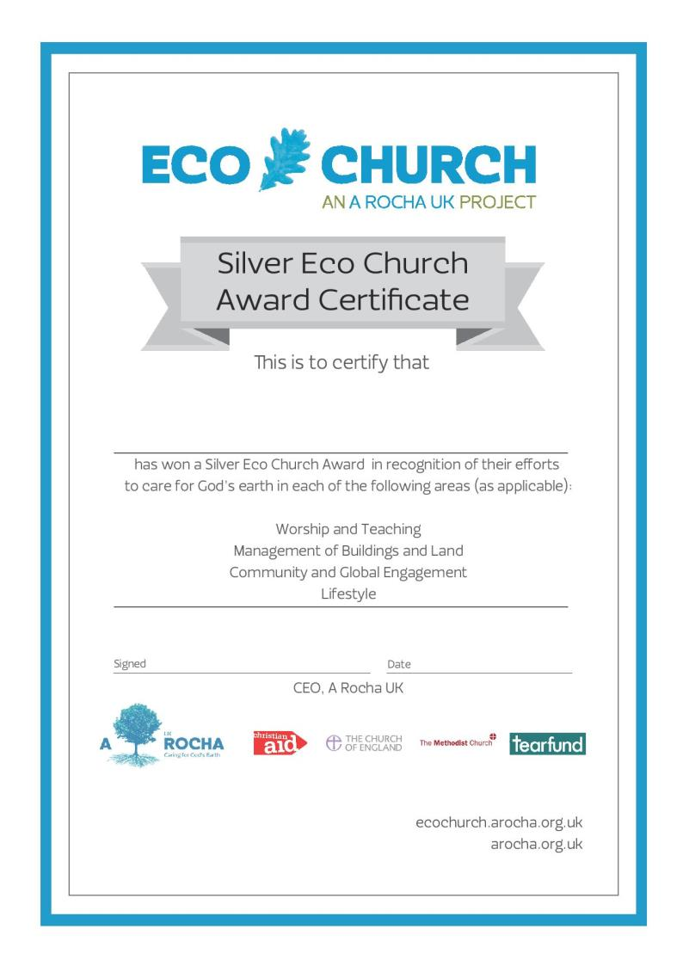

Slide 37
The ‘Living Lightly 24:1’ plan
A simpler, greener lifestyle commitment
Introduced by the Christian conservation organisation, A Rocha UK
Psalm 24: 1: ‘The earth is the Lord’s and everything in it’
The 24:1 Commitment - believing
The 24:1 Challenge - behaving
The 24:1 Challenge - belonging
A Rocha: Dave Bookless (2008) Planetwise IVP p.118-122

Slide 38
The ‘Living Lightly 24:1’ plan
The 24:1 Commitment: ‘The earth is the Lord’s and everything in it’
Believing that this is God’s world, entrusted to our responsible use and care, and that living sustainably is part of Christian worship and mission
A Rocha: Dave Bookless (2008) Planetwise IVP p.118-122

Slide 39
The ‘Living Lightly 24:1’ plan
The 24:1 Challenge: Living lightly in God’s world
  Behaving differently
A Rocha: Dave Bookless (2008) Planetwise IVP p.118-122

Slide 40
The ‘Living Lightly 24:1’ plan
The 24:1 Community: caring for God’s world together
  Belonging in a renewed way to God, to my local community, to the place where God has put me, and to the family of creation
A Rocha: Dave Bookless (2008) Planetwise IVP p.118-122

Slide 41
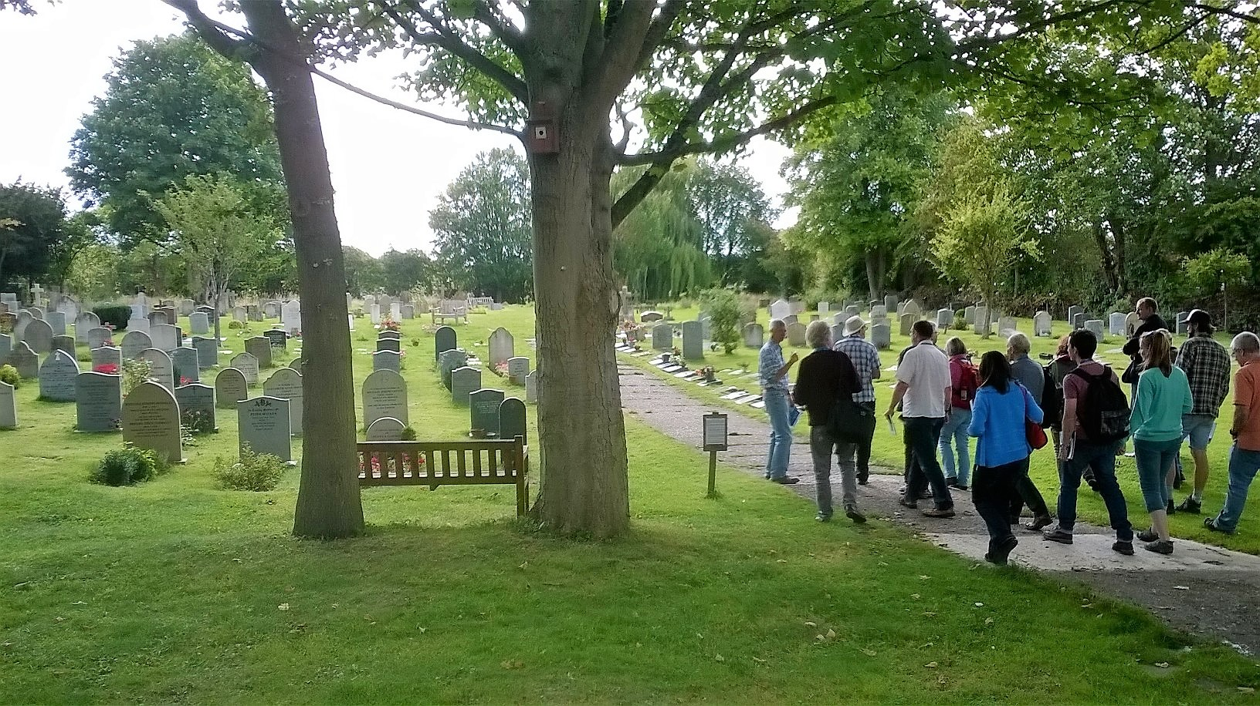
Christian land managers –
Partners in Action
Locally owned and managed conservation projects
A Rocha provides expertise and resources to help support community groups around the country (9 so far) e.g. Chinnor Churches go Wild project, Oxfordshire
Aim: to increase accessibility to green space, enhance biodiversity and educate people about the environment

Slide 42
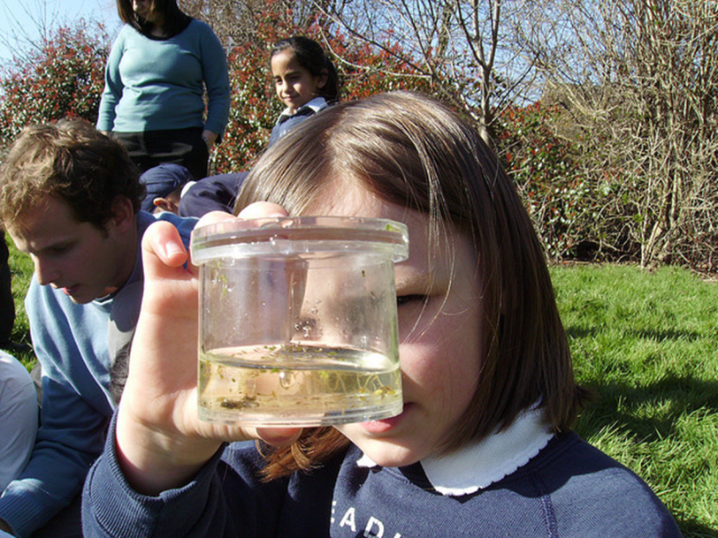
Hope for the future, Wolf Fields Nature Reserve

Slide 43
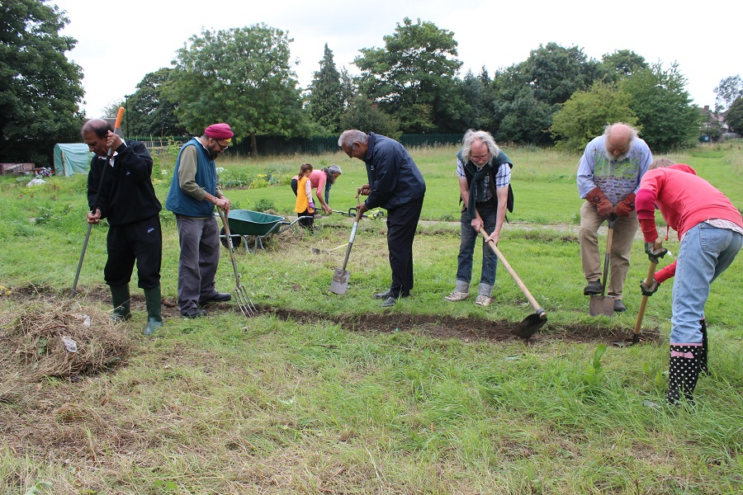
Waste land to wonderland, Wolf fields, Southall

Slide 44
https://ecochurch.arocha.org.uk/

