Slide 2
An international Catholic organisation that is a work of the Society of Jesus (the Jesuits)
found in 51 countries
Internationally our main areas of work are within education, emergency assistance, healthcare, livelihood activities and social services
Notes:
The Jesuit Refugee Service (JRS) is an international Catholic organisation with a mission to accompany, serve and advocate on behalf of refugees and other forcibly displaced persons.
JRS programmes can be found in over 50 countries providing assistance to: refugees in camps and cities, internally displaced people, asylum seekers in cities and those asylum seekers and refugees held in detention centres.
The majority of JRS’ work is concentrated on education, emergency assistance, healthcare, livelihood activities and social services.
At the end of 2016, more than 733,400 individuals were in direct beneficiaries of JRS projects.
JRS also advocate on behalf of refugees and their human rights

Slide 3
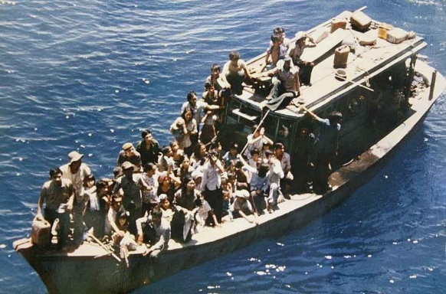
JRS was born out of the concern of Fr. Arrupe SJ for the thousands of Vietnamese boat people fleeing their war-torn country.
Founded in November 1980 as a work of the Society of Jesus, JRS was officially registered on 19 March 2000 at the Vatican State as a foundation
“St Ignatius called us to go anywhere we are most needed for the greater service of God. The spiritual as well as material need of nearly 16 million refugees throughout the world today could scarcely be greater.” Pedro Arrupe SJ 14, November 1980

Slide 4
The mission of the Jesuit Refugee Service is to accompany, serve and advocate for the rights of refugees and other forcibly displaced persons.
Notes:
The Jesuit Refugee Service (JRS) is an international Catholic organisation with a mission to accompany, serve and advocate on behalf of refugees and other forcibly displaced persons.
JRS programmes can be found in over 50 countries providing assistance to: refugees in camps and cities, internally displaced people, asylum seekers in cities and those asylum seekers and refugees held in detention centres.
The majority of JRS’ work is concentrated on education, emergency assistance, healthcare, livelihood activities and social services.
At the end of 2016, more than 733,400 individuals were in direct beneficiaries of JRS projects.
JRS also advocate on behalf of refugees and their human rights

Slide 5
JRS attend the Welfare Centres in both Harmondsworth and Colnbrook Immigration Removal Centres, near Heathrow, on a weekly basis.
We are able to help make referrals to specialist services and we operate a legal liaison service to help ensure better communication between detainees and their solicitors.
Our volunteer visitors offer friendship and a listening ear to those who are left to feel abandoned and lonely.
Notes:
The Jesuit Refugee Service (JRS) is an international Catholic organisation with a mission to accompany, serve and advocate on behalf of refugees and other forcibly displaced persons.
JRS programmes can be found in over 50 countries providing assistance to: refugees in camps and cities, internally displaced people, asylum seekers in cities and those asylum seekers and refugees held in detention centres.
The majority of JRS’ work is concentrated on education, emergency assistance, healthcare, livelihood activities and social services.
At the end of 2016, more than 733,400 individuals were in direct beneficiaries of JRS projects.
JRS also advocate on behalf of refugees and their human rights

Slide 6
JRS accompanies destitute asylum seekers who receive no financial support from Government and rely on charities and the kindness of others.
Those who attend our weekly day centre in Wapping receive travel money so that they can access important legal and medical appointments, emergency mini-grants to newly destitute individuals and a healthy warm lunch.
Our Day Centre is a safe space to rest, get referrals to key services and meet friends over a cup of tea or coffee.
Each month we give out over 200 toiletry packs and we often distribute clothing and food parcels.
Notes:
The Jesuit Refugee Service (JRS) is an international Catholic organisation with a mission to accompany, serve and advocate on behalf of refugees and other forcibly displaced persons.
JRS programmes can be found in over 50 countries providing assistance to: refugees in camps and cities, internally displaced people, asylum seekers in cities and those asylum seekers and refugees held in detention centres.
The majority of JRS’ work is concentrated on education, emergency assistance, healthcare, livelihood activities and social services.
At the end of 2016, more than 733,400 individuals were in direct beneficiaries of JRS projects.
JRS also advocate on behalf of refugees and their human rights

Slide 7
The Hostile Environment (or compliance environment) frames the entire asylum system.
A deliberately harsh regime: aims to put off those seeking sanctuary from coming to the UK
All asylum seekers viewed with hermeneutic of suspicion
Once asylum is refused, web of punitive policies & legislation kicks in
More difficult to regularise your case and have Refugee Status Acknowledged.
Notes:
The Hostile Environment:
A deliberately harsh regime: aims to put off those seeking sanctuary from coming to the UK; e.g. low level of asylum support S95(impact of so-called “pull factors” is strongly contested).
All asylum seekers viewed with hermeneutic of suspicion: affects their ability to get fair hearing in asylum determination system (and increases the trauma of experience)
Once asylum is refused, web of punitive policies & legislation kicks in: aiming to make life in UK unbearable for undocumented migrants & refused asylum seekers, to persuade them to leave UK
The reality of the Hostile Environment makes it more difficult to regularise your case and have Refugee Status Acknowledged.

Slide 8
No way to meet basic needs
Bank accounts Frozen
Risk of Detention
No access to Rental Market
Constant Worry
No Access to support
Ban on work
Anxiety
Appeals Rights Exhausted
Reporting
Study Ban
Street Homeless
Forced Destitution
Reduced access to Healthcare
Fear of Removal
Difficult to further asylum case
Criminalisation of daily activities
Isolated
Loss of Dignity
Completely dependent on others
Notes:
Appeals Rights Exhausted:
At the point that an individual becomes Appeals Rights Exhausted they become known as a refused asylum seeker and are expected to leave the UK.
Refused asylum seekers have all government support cut and become and individuals are forced into destitution. The UK Government uses destitution as a purposeful tool as part of its Hostile Environment Agenda. It is deliberate, enforced destitution.
Ban on work and no access to support – no legal way to earn money
Reduced access to free healthcare
Criminalisation of daily activities e.g. driving
No access to rental market or banking
Fighting your asylum case becomes impossibly difficult when you are destitute:
Uncertainty and constant worry about basic necessities makes it hard to concentrate on the asylum case
You can’t afford to pay for transport to submit a fresh claim.

Slide 9
“A direct and personal approach of individual interaction, cooperation and companionship between people, which places a value on human dignity and in the long-term leads to mutual empowerment”.
- Taken from JRS Europe’s recent publication, I Get You
Notes:
The Jesuit Refugee Service (JRS) is an international Catholic organisation with a mission to accompany, serve and advocate on behalf of refugees and other forcibly displaced persons.
JRS programmes can be found in over 50 countries providing assistance to: refugees in camps and cities, internally displaced people, asylum seekers in cities and those asylum seekers and refugees held in detention centres.
The majority of JRS’ work is concentrated on education, emergency assistance, healthcare, livelihood activities and social services.
At the end of 2016, more than 733,400 individuals were in direct beneficiaries of JRS projects.
JRS also advocate on behalf of refugees and their human rights

Slide 10
A direct and personal approach
Notes:
The Jesuit Refugee Service (JRS) is an international Catholic organisation with a mission to accompany, serve and advocate on behalf of refugees and other forcibly displaced persons.
JRS programmes can be found in over 50 countries providing assistance to: refugees in camps and cities, internally displaced people, asylum seekers in cities and those asylum seekers and refugees held in detention centres.
The majority of JRS’ work is concentrated on education, emergency assistance, healthcare, livelihood activities and social services.
At the end of 2016, more than 733,400 individuals were in direct beneficiaries of JRS projects.
JRS also advocate on behalf of refugees and their human rights

Slide 11
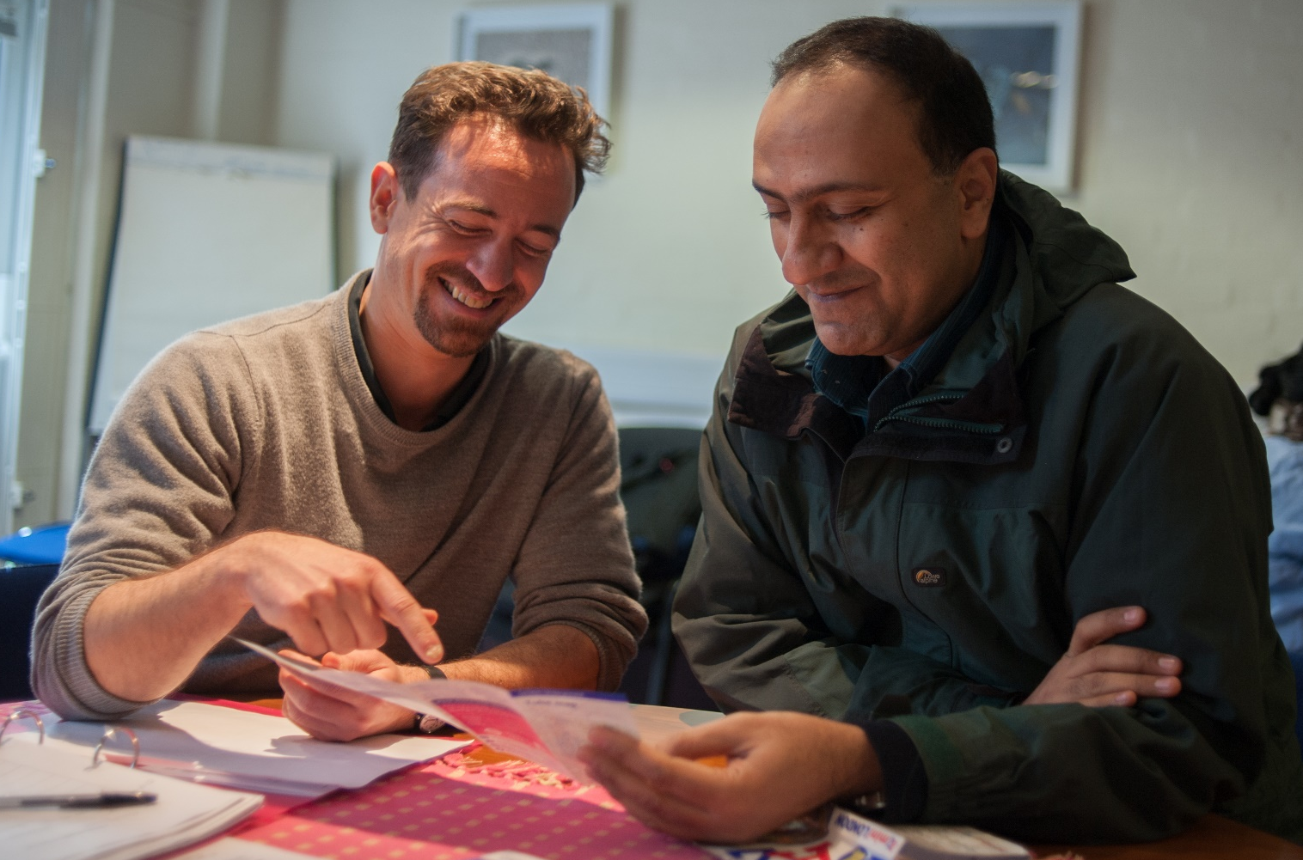
individual interaction
Notes:
The Jesuit Refugee Service (JRS) is an international Catholic organisation with a mission to accompany, serve and advocate on behalf of refugees and other forcibly displaced persons.
JRS programmes can be found in over 50 countries providing assistance to: refugees in camps and cities, internally displaced people, asylum seekers in cities and those asylum seekers and refugees held in detention centres.
The majority of JRS’ work is concentrated on education, emergency assistance, healthcare, livelihood activities and social services.
At the end of 2016, more than 733,400 individuals were in direct beneficiaries of JRS projects.
JRS also advocate on behalf of refugees and their human rights

Slide 12
cooperation
Notes:
The Jesuit Refugee Service (JRS) is an international Catholic organisation with a mission to accompany, serve and advocate on behalf of refugees and other forcibly displaced persons.
JRS programmes can be found in over 50 countries providing assistance to: refugees in camps and cities, internally displaced people, asylum seekers in cities and those asylum seekers and refugees held in detention centres.
The majority of JRS’ work is concentrated on education, emergency assistance, healthcare, livelihood activities and social services.
At the end of 2016, more than 733,400 individuals were in direct beneficiaries of JRS projects.
JRS also advocate on behalf of refugees and their human rights

Slide 13
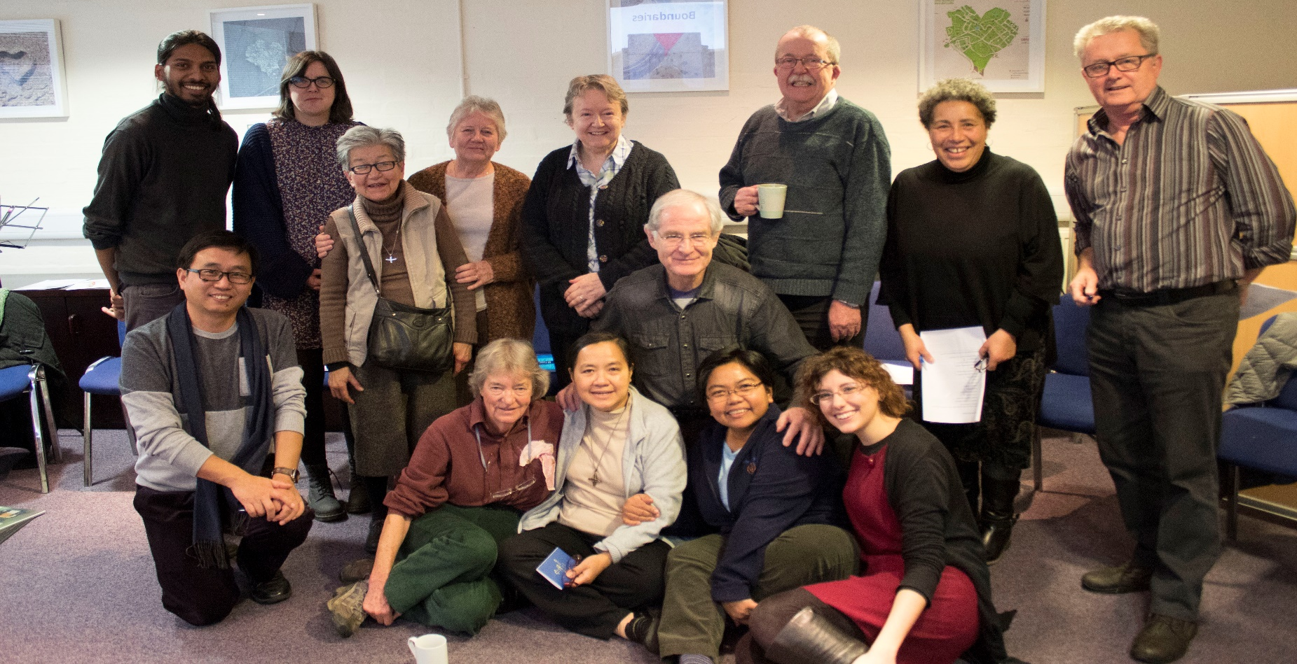
companionship
Notes:
The Jesuit Refugee Service (JRS) is an international Catholic organisation with a mission to accompany, serve and advocate on behalf of refugees and other forcibly displaced persons.
JRS programmes can be found in over 50 countries providing assistance to: refugees in camps and cities, internally displaced people, asylum seekers in cities and those asylum seekers and refugees held in detention centres.
The majority of JRS’ work is concentrated on education, emergency assistance, healthcare, livelihood activities and social services.
At the end of 2016, more than 733,400 individuals were in direct beneficiaries of JRS projects.
JRS also advocate on behalf of refugees and their human rights

Slide 14
“A direct and personal approach of individual interaction, cooperation and companionship between people, which places a value on human dignity and in the long-term leads to mutual empowerment”.
- Taken from JRS Europe’s recent publication, I Get You
Notes:
The Jesuit Refugee Service (JRS) is an international Catholic organisation with a mission to accompany, serve and advocate on behalf of refugees and other forcibly displaced persons.
JRS programmes can be found in over 50 countries providing assistance to: refugees in camps and cities, internally displaced people, asylum seekers in cities and those asylum seekers and refugees held in detention centres.
The majority of JRS’ work is concentrated on education, emergency assistance, healthcare, livelihood activities and social services.
At the end of 2016, more than 733,400 individuals were in direct beneficiaries of JRS projects.
JRS also advocate on behalf of refugees and their human rights

Slide 15
“Whenever I visit the centre it is like going to visit my long-term friends”.
- One of JRS’s friends
Notes:
The Jesuit Refugee Service (JRS) is an international Catholic organisation with a mission to accompany, serve and advocate on behalf of refugees and other forcibly displaced persons.
JRS programmes can be found in over 50 countries providing assistance to: refugees in camps and cities, internally displaced people, asylum seekers in cities and those asylum seekers and refugees held in detention centres.
The majority of JRS’ work is concentrated on education, emergency assistance, healthcare, livelihood activities and social services.
At the end of 2016, more than 733,400 individuals were in direct beneficiaries of JRS projects.
JRS also advocate on behalf of refugees and their human rights

Slide 16
Thank you for listening!

