Slide 1
Engaging young(er) people with ‘Justice and Peace’
James Trewby
Columban Justice and Peace Education
Notes:
Welcome

Slide 2
My background
- Teaching
- MSc: “A pedagogy of the gap year”
- Bosco Volunteer Action
- PhD “Journeys to and within engagement”
- Columban Justice and Peace Education

Slide 3
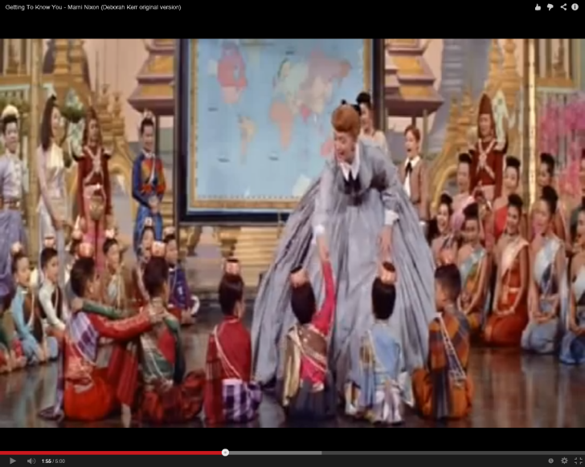
“Getting to know you, getting to know all about you”
Notes:
Useful quote from Matt

Slide 4
Let’s start positive
Notes:
Welcome

Slide 5
Some encouraging news
It’s possible
They’re interested
They’re active
It’s never too early
We’ll never see all the results
Notes:
It’s possible:
Examples - Rach – Blackpool and MP,
They’re interested:
Gov doc “issues that are of direct concern to young people” (QCA, 2007:2).
Research shows that the majority of children feel they can do something to bring about positive change (Holden, 2007).
It’s never too early:
Puppet

Slide 6
Young people engaged with…
…‘j&p issues’
…‘the Church’
Notes:
Welcome

Slide 7
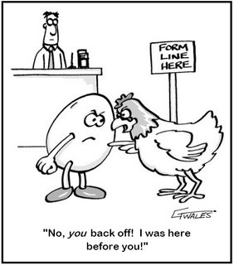
Faith and action
A complex relationship!
Notes:
Action is often considered a key aspect of development education practice
But debate exists:
Learning and then action
Action then learning
Learning thru action
Lots of examples of learning taking place while doing, including learning across the movement
e.g. Jules, people and social justice to environmental via Occupy
Broker issues – (Della Porta, 2007, p. 16)
Low cost/risk
McAdam (freedom summer) - a ‘taste’ of engagement can act as a significant learning experience, possibly leading to a greater commitment at a later stage.
Similar suggestions can be found in Banaji et al’s consideration of a “pedagogy of civic engagement” (Banaji et al., 2009, p. 15) and Mayo’s suggestion that participating in social movements can be an educative process in itself (Mayo, 2005).
Rebecca’s first march
A story which Rebecca uses to show her ‘becoming’ an activist is her description of attending a Free Tibet march in London:
“[T]hat was amazing and we heard like, testimonies from Buddhist nuns who were like, imprisoned in the occupation … and it was just … amazing. And just being around so many people was amazing … it just helped me to understand … protests… and the struggle of them. And seeing the police and seeing … erm… it was just, it was just so fascinating to me, and I just talked to the founder of [a campaigning NGO] [at her university], we met him in London and he was just really amazing and he talked about the Chaplaincy as well and I’d already been in the Chaplaincy and it was, it was just really cool that he was, I just looked up, I just looked up to people who were so involved …and … I just got really erm … I was just really proud to be so close erm, to what was happening and to be committed enough to go to it I think … and , I just, erm… told lots of people about it … and bought a Free Tibet scarf… yeah, it just, I think that was an important time because that was the first big protest that I went on. And then after that I just felt like I was involved in the Global Justice Movement … erm and by taking part in that march I was, yeah, it was I like I was, erm, in then.”
This story has incredible parallels with the example McAdam uses to explain his concept of low cost/risk (McAdam, 1986, p. 69):
a young man attends a peace rally, where three things happen. Firstly he broadens “his range of movement contacts”. Secondly, talking to others and listening to speakers he “may well develop a better and more sympathetic understanding” of the movement. Finally, he may feel encouraged to ‘play at’ being an activist. Rebecca’s story is strikingly similar to this example. She refers to meeting people, says she gained understanding and felt like she “was in”, that she belonged in some way. McAdam goes on to suggest that “it is precisely these tentative forays into new roles that pave the way for more thoroughgoing identity changes… playing at being an “activist” is a prerequisite to becoming one” (McAdam, 1986, p. 69), and that an experience of low cost/risk engagement may lead to a higher one at a subsequent stage. In a later analysis he observes that “people commit themselves to movements in stages, each activity preparing the way for the next” (McAdam, 2003, p. 61). Moving through Rebecca’s story this appears to be the case. This march helps her to claim the identity of engagement for herself and proves to be the first of many.
Can’t assume people always go deeper – Tom Cromptom “No virtuous escalator” (Crompton, 2008, p. 14)
Educators may hope that these small steps lead to more significant action at some later stage, an assumption which is certainly open to challenge
Learning through visits overseas
More complex than I had previously suggested – limited to gap year thinking
Respondents had range of global exposures – childhood visits etc
2 I’d like to draw particular attention to
Rebecca disorientated by visit to India; her visit to India as part of her university degree challenged her belief that she could really ‘make a difference’:
“Just being face to face with, with people living poverty… and meeting the people who I’d been campaigning for…in those moments I felt helpless…and I… I felt like quite disempowered actually … I think when I went to India that was probably a bit of a shock to my senses, to realise that it’s not just as easy as campaigning for a cause and people are getting exploited and I can’t just step in and ask someone to sign a petition, even though that helps”.
Rebecca then goes on to question her particular forms of engagement: “Why was I doing this, shouldn’t I be doing something better, something that’s going to make more of a difference?”
This visit therefore served to challenge her, destabilising, and perhaps eventually deepening, her commitment to global justice. Learning here is shown to be much more complex than the relatively simple model proposed in Trewby (2007); it is not simply experience-reflection-action, but instead experience leading to challenging and messy questions forcing reflection on both global justice issues and her responses to them.
Experiential learning via visits overseas also plays a significant role in Ayo’s story, but with a significant difference.
Ayo was born in Nigeria into a relatively wealthy family, coming to the UK when she was ten and moving between the two countries many times.
She discovers injustice and poverty in the UK:
“I’d never seen people who had nothing, who basically were living, like on benefits, in a room somehow with the rest of, I’d never seen that, I didn’t know people lived like that.”
This had a significant impact on her, “opening up her world view” and providing her with a sense that “this isn't right and you should do something about it”.
It also led her to see Nigeria with “new eyes”, becoming angry about other peoples’ lack of access to power:
“I kind of realised actually you can’t forget about these people, they’re like everywhere, they’re poor, they’re struggling, they’re angry, I guess, because I realised I was quite angry about not having access to things and maybe for me it was the first time in my life that I wasn’t part of the powerful group”. Although she had seen ‘the poor’ of Nigeria many times previously, and in fact been active in a number of charitable initiatives with her family, her experiences in London provided her with a new perspective and empathetic understanding of injustice leading to new learning.
Ayo’s experiential learning described above can be seen to mirror some of the learning experiences of people from the UK visiting ‘developing’ countries, and experiential development education models explored by Trewby (2007), Simpson (2004) and others. It raises important questions about the power of “distanciation” and the ‘exotic’ in learning, and emphasises the potential impact of education practices which act to develop feelings of empathy.

Slide 8
Where learning happens?
The role of formal education
Conflicting results
Soft/Critical
Fundraising? Fleas
Action? “Just depressing”
Experiences rather than what taught?
Notes:
Schools have been the main focus of development education practice in the UK (Bourn and Brown, 2011, p. 13).
Lots invested
But v little appears in my respondents’ stories
Doesn’t mean it’s not significant
But maybe not as important as we might think?
What’s the issue with schools?
Are they place suitable for critical DE?
Andreotti (2006a) and others - ‘soft’ and ‘critical’ global citizenship (charity/justice, non-radical/radical, political, cause/consequence)
Not easy to do critical
1) Often educators have learned fundraising as “go to” response.
Andreotti argues all (incl teachers) “already conditioned (but not determined) by our social, cultural and historical contexts” (de Oliveira Andreotti, 2013, p. 12).
So, for example, if an educator, influenced by the media, their own education and learning experiences, believes that the answer to injustice is solely charity, they are unlikely to be open to more critical approaches to development education.
Hence the general consensus appears to be that schools “tend to promote a ‘soft’, non-threatening global learning” (Hunt, 2012, p. 10), largely rooted in charitable activities (Smith, 2004, p. 745) such as fundraising (Hunt, 2012, p. 37).
2) “the desired social action is often designed around the consumer, the Northern student”, fitting in with the timetable and “user-friendly for the teacher and the classroom setting” (Tallon, 2012a, p. 9).
The need to include a ‘quick-fix’ response to injustice often results in a fundraising initiative, which while positive in some ways, risks re-affirming and continuing learners’ education ‘in charity’ at the cost of a more challenging education ‘in justice’.
Reflected in their stories.
However, not all bad – their success in organising events builds identity (discussed later)
Learning happens – sometimes leading to unexpected results
Jules – holocaust education leading to anti-homophobia activities (making him an educator)
Ayo heating, aged around 14.
“There was an issue in my school in that heating came on the 31st of October that was the rule, it didn’t come on before… and it was a particularly cold autumn, it was like really really cold, and I remember a lot of us were studying, I think it was GCSEs or some other exam, and we were all in our rooms, studying, and we were wearing coats and hats and gloves, and it suddenly occurred to me, my parents are paying a fortune to this school, and I’m literally sitting here in gloves, like freezing cold, trying to study. This is completely ridiculous. So, people were kind of bitching about it and stuff, so I went down the corridor like, “Who wants to come with me?”, and everyone was like, “Yeah no, it’s not right, it’s not right”. … I went to find the caretaker guy to find out why the heating couldn’t be turned on as we were all freezing cold. And I think three people came with me then. And he was like, “Oh it’s not my fault love, you need to speak to the bursar because he told me I can’t turn it on until the end of the month” and so I marched onto the bursar, I think I’d lost one person by then, so it was just me and some other girl, and went, “Well like you’ve got to turn on the heating”, he’s like, “Well no, I don’t actually, we don’t turn it on til the 31st”. And I said, “It’s freezing, it’s warmer outside than it is in the building, that’s surely ridiculous” and he’s like, “Well you can’t talk to me like that” and the other girl sulked off so I was left on my own and I was like, “Well actually I can, cos I think you’ll find my parents pay your salary, so the least you could do is make sure that I don’t die!”. He’s like, “Well, I’m reporting you to the headmistress”, so I got marched off to the headmistress and she’s like, “You can’t talk to people like that and we know what we’re doing” and I said, “Well actually, no you don’t. You see the thing is, this is like some massive scam that you’ve got going here and what I’m going to do, is I’m going to give you a day to think about what you want to do and by the end of that day, if you’re not ready to put the heating on, I’m going to call the Oxford Times, I’m going to call this person, I’m going to call that person, I’m going to make sure everyone’s really aware of the fact that, despite the fact that you have more than enough money to turn on the heating, you’re still leaving children, children, people’s children” and she sort of looked at me, and I think she didn’t think that I was going to see it through so I called a couple of papers and I told them to ask her whether they’d be allowed into the school and so they called her, and pretty much in 24 hours we had heating on!”
V well told story; it has a beginning, with the students revising in the cold, a middle, in which Ayo agitates for change, and an end, in which the situation is resolved. It may be that that it is a story Ayo has told before, perhaps as an ontological narrative used to ‘tell’ herself. It shows her as someone who cares about justice with a sense of her own power and how she can use it to bring about change. It also clearly frames Ayo as a leader amongst her peers. She is shown to have the agency to instigate change, with others and on her own. Her leadership is highlighted particularly by the way she tells of the gradual reduction of her schoolmates’ involvement. At the beginning “everyone” was with her. These then drop away one by one so that by the time she reaches the headmistress she is on her own, standing out amongst her peers. In addition, through threatening exposure in the media she shows an understanding of the power of information, perhaps foreshadowing her later use of social media.

Slide 9
Notes:
Schools have been the main focus of development education practice in the UK (Bourn and Brown, 2011, p. 13).
Lots invested
But v little appears in my respondents’ stories
Doesn’t mean it’s not significant
But maybe not as important as we might think?
What’s the issue with schools?
Are they place suitable for critical DE?
Andreotti (2006a) and others - ‘soft’ and ‘critical’ global citizenship (charity/justice, non-radical/radical, political, cause/consequence)
Not easy to do critical
1) Often educators have learned fundraising as “go to” response.
Andreotti argues all (incl teachers) “already conditioned (but not determined) by our social, cultural and historical contexts” (de Oliveira Andreotti, 2013, p. 12).
So, for example, if an educator, influenced by the media, their own education and learning experiences, believes that the answer to injustice is solely charity, they are unlikely to be open to more critical approaches to development education.
Hence the general consensus appears to be that schools “tend to promote a ‘soft’, non-threatening global learning” (Hunt, 2012, p. 10), largely rooted in charitable activities (Smith, 2004, p. 745) such as fundraising (Hunt, 2012, p. 37).
2) “the desired social action is often designed around the consumer, the Northern student”, fitting in with the timetable and “user-friendly for the teacher and the classroom setting” (Tallon, 2012a, p. 9).
The need to include a ‘quick-fix’ response to injustice often results in a fundraising initiative, which while positive in some ways, risks re-affirming and continuing learners’ education ‘in charity’ at the cost of a more challenging education ‘in justice’.
Reflected in their stories.
However, not all bad – their success in organising events builds identity (discussed later)
Learning happens – sometimes leading to unexpected results
Jules – holocaust education leading to anti-homophobia activities (making him an educator)
Ayo heating, aged around 14.
“There was an issue in my school in that heating came on the 31st of October that was the rule, it didn’t come on before… and it was a particularly cold autumn, it was like really really cold, and I remember a lot of us were studying, I think it was GCSEs or some other exam, and we were all in our rooms, studying, and we were wearing coats and hats and gloves, and it suddenly occurred to me, my parents are paying a fortune to this school, and I’m literally sitting here in gloves, like freezing cold, trying to study. This is completely ridiculous. So, people were kind of bitching about it and stuff, so I went down the corridor like, “Who wants to come with me?”, and everyone was like, “Yeah no, it’s not right, it’s not right”. … I went to find the caretaker guy to find out why the heating couldn’t be turned on as we were all freezing cold. And I think three people came with me then. And he was like, “Oh it’s not my fault love, you need to speak to the bursar because he told me I can’t turn it on until the end of the month” and so I marched onto the bursar, I think I’d lost one person by then, so it was just me and some other girl, and went, “Well like you’ve got to turn on the heating”, he’s like, “Well no, I don’t actually, we don’t turn it on til the 31st”. And I said, “It’s freezing, it’s warmer outside than it is in the building, that’s surely ridiculous” and he’s like, “Well you can’t talk to me like that” and the other girl sulked off so I was left on my own and I was like, “Well actually I can, cos I think you’ll find my parents pay your salary, so the least you could do is make sure that I don’t die!”. He’s like, “Well, I’m reporting you to the headmistress”, so I got marched off to the headmistress and she’s like, “You can’t talk to people like that and we know what we’re doing” and I said, “Well actually, no you don’t. You see the thing is, this is like some massive scam that you’ve got going here and what I’m going to do, is I’m going to give you a day to think about what you want to do and by the end of that day, if you’re not ready to put the heating on, I’m going to call the Oxford Times, I’m going to call this person, I’m going to call that person, I’m going to make sure everyone’s really aware of the fact that, despite the fact that you have more than enough money to turn on the heating, you’re still leaving children, children, people’s children” and she sort of looked at me, and I think she didn’t think that I was going to see it through so I called a couple of papers and I told them to ask her whether they’d be allowed into the school and so they called her, and pretty much in 24 hours we had heating on!”
V well told story; it has a beginning, with the students revising in the cold, a middle, in which Ayo agitates for change, and an end, in which the situation is resolved. It may be that that it is a story Ayo has told before, perhaps as an ontological narrative used to ‘tell’ herself. It shows her as someone who cares about justice with a sense of her own power and how she can use it to bring about change. It also clearly frames Ayo as a leader amongst her peers. She is shown to have the agency to instigate change, with others and on her own. Her leadership is highlighted particularly by the way she tells of the gradual reduction of her schoolmates’ involvement. At the beginning “everyone” was with her. These then drop away one by one so that by the time she reaches the headmistress she is on her own, standing out amongst her peers. In addition, through threatening exposure in the media she shows an understanding of the power of information, perhaps foreshadowing her later use of social media.

Slide 10
Where learning happens?
The role of formal education
Conflicting results
Soft/Critical
Fundraising?
Action? “Just depressing”
Experiences rather than what taught?
Notes:
Schools have been the main focus of development education practice in the UK (Bourn and Brown, 2011, p. 13).
Lots invested
But v little appears in my respondents’ stories
Doesn’t mean it’s not significant
But maybe not as important as we might think?
What’s the issue with schools?
Are they place suitable for critical DE?
Andreotti (2006a) and others - ‘soft’ and ‘critical’ global citizenship (charity/justice, non-radical/radical, political, cause/consequence)
Not easy to do critical
1) Often educators have learned fundraising as “go to” response.
Andreotti argues all (incl teachers) “already conditioned (but not determined) by our social, cultural and historical contexts” (de Oliveira Andreotti, 2013, p. 12).
So, for example, if an educator, influenced by the media, their own education and learning experiences, believes that the answer to injustice is solely charity, they are unlikely to be open to more critical approaches to development education.
Hence the general consensus appears to be that schools “tend to promote a ‘soft’, non-threatening global learning” (Hunt, 2012, p. 10), largely rooted in charitable activities (Smith, 2004, p. 745) such as fundraising (Hunt, 2012, p. 37).
2) “the desired social action is often designed around the consumer, the Northern student”, fitting in with the timetable and “user-friendly for the teacher and the classroom setting” (Tallon, 2012a, p. 9).
The need to include a ‘quick-fix’ response to injustice often results in a fundraising initiative, which while positive in some ways, risks re-affirming and continuing learners’ education ‘in charity’ at the cost of a more challenging education ‘in justice’.
Reflected in their stories.
However, not all bad – their success in organising events builds identity (discussed later)
Learning happens – sometimes leading to unexpected results
Jules – holocaust education leading to anti-homophobia activities (making him an educator)
Ayo heating, aged around 14.
“There was an issue in my school in that heating came on the 31st of October that was the rule, it didn’t come on before… and it was a particularly cold autumn, it was like really really cold, and I remember a lot of us were studying, I think it was GCSEs or some other exam, and we were all in our rooms, studying, and we were wearing coats and hats and gloves, and it suddenly occurred to me, my parents are paying a fortune to this school, and I’m literally sitting here in gloves, like freezing cold, trying to study. This is completely ridiculous. So, people were kind of bitching about it and stuff, so I went down the corridor like, “Who wants to come with me?”, and everyone was like, “Yeah no, it’s not right, it’s not right”. … I went to find the caretaker guy to find out why the heating couldn’t be turned on as we were all freezing cold. And I think three people came with me then. And he was like, “Oh it’s not my fault love, you need to speak to the bursar because he told me I can’t turn it on until the end of the month” and so I marched onto the bursar, I think I’d lost one person by then, so it was just me and some other girl, and went, “Well like you’ve got to turn on the heating”, he’s like, “Well no, I don’t actually, we don’t turn it on til the 31st”. And I said, “It’s freezing, it’s warmer outside than it is in the building, that’s surely ridiculous” and he’s like, “Well you can’t talk to me like that” and the other girl sulked off so I was left on my own and I was like, “Well actually I can, cos I think you’ll find my parents pay your salary, so the least you could do is make sure that I don’t die!”. He’s like, “Well, I’m reporting you to the headmistress”, so I got marched off to the headmistress and she’s like, “You can’t talk to people like that and we know what we’re doing” and I said, “Well actually, no you don’t. You see the thing is, this is like some massive scam that you’ve got going here and what I’m going to do, is I’m going to give you a day to think about what you want to do and by the end of that day, if you’re not ready to put the heating on, I’m going to call the Oxford Times, I’m going to call this person, I’m going to call that person, I’m going to make sure everyone’s really aware of the fact that, despite the fact that you have more than enough money to turn on the heating, you’re still leaving children, children, people’s children” and she sort of looked at me, and I think she didn’t think that I was going to see it through so I called a couple of papers and I told them to ask her whether they’d be allowed into the school and so they called her, and pretty much in 24 hours we had heating on!”
V well told story; it has a beginning, with the students revising in the cold, a middle, in which Ayo agitates for change, and an end, in which the situation is resolved. It may be that that it is a story Ayo has told before, perhaps as an ontological narrative used to ‘tell’ herself. It shows her as someone who cares about justice with a sense of her own power and how she can use it to bring about change. It also clearly frames Ayo as a leader amongst her peers. She is shown to have the agency to instigate change, with others and on her own. Her leadership is highlighted particularly by the way she tells of the gradual reduction of her schoolmates’ involvement. At the beginning “everyone” was with her. These then drop away one by one so that by the time she reaches the headmistress she is on her own, standing out amongst her peers. In addition, through threatening exposure in the media she shows an understanding of the power of information, perhaps foreshadowing her later use of social media.

Slide 11
Ideas and approaches
Learning through encounter/experience
Focus on values and tools not issues
Who’s the best person for the job?
Exploring engagement with families

Slide 12
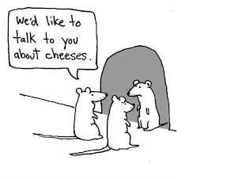
Many thanks
education@columbans.co.uk

Slide 13
Experiential Learning
“When he had washed their feet and put on his clothes again he went back to the table. ‘Do you understand’ he said ‘what I have done to you? You call me Master and Lord, and rightly; so I am. If I, then, the Lord and Master, have washed your feet, you should wash each other’s feet. I have given you an example so that you may copy what I have done to you.”
John 13: 1-15
Notes:
The story of Jesus washing his disciples’ feet is one I often explore with groups of educators.
It’s a beautiful story of service and of being really present to those you are with.
But I believe it contains another message from Jesus to his followers
– the challenge to learn by ‘trying on someone else’s shoes’. Putting oneself in a new position opens up the opportunity to see the world from a new perspective.

Slide 14
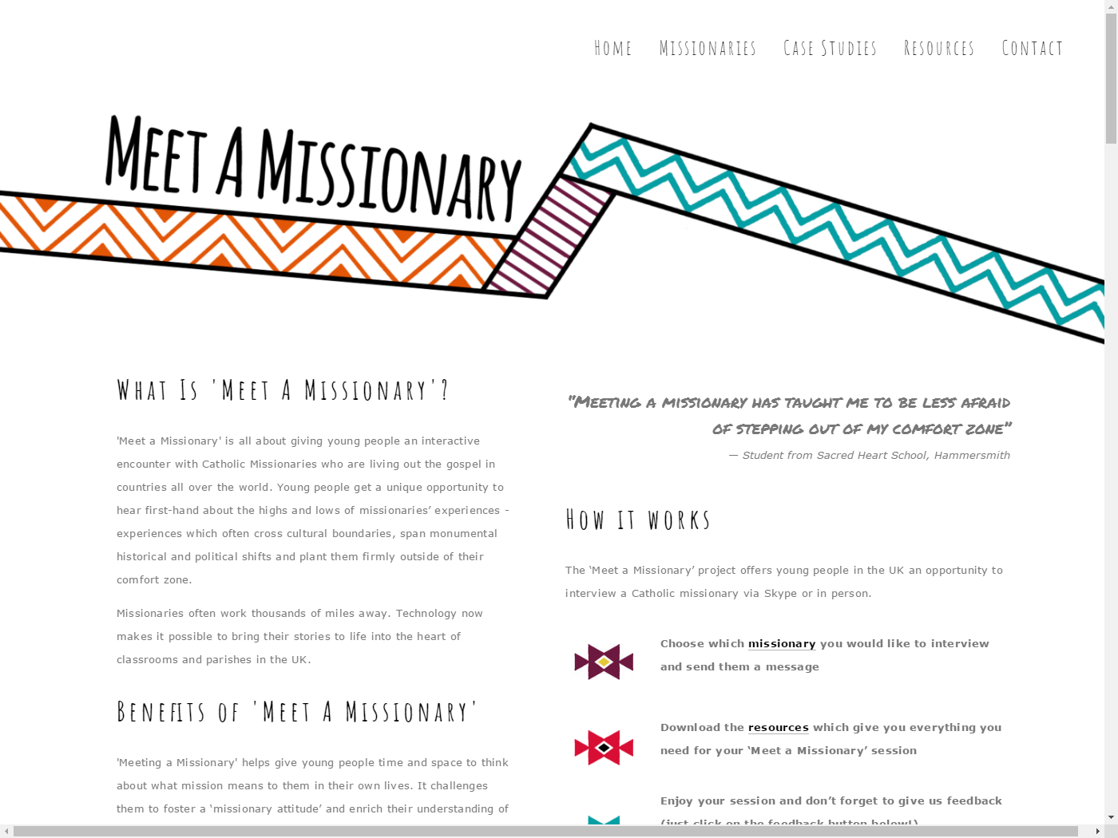
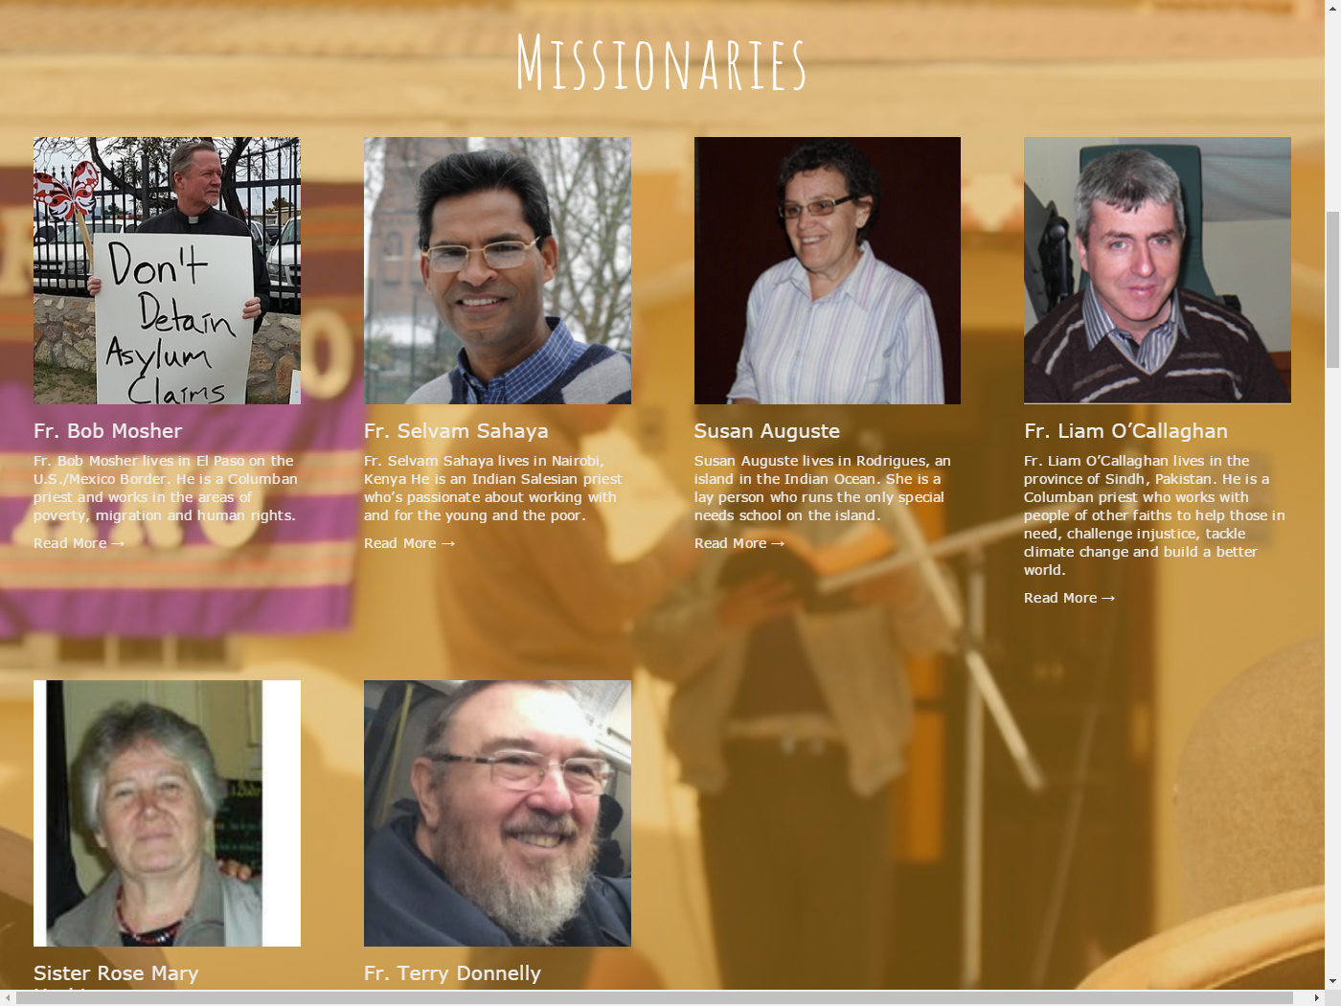
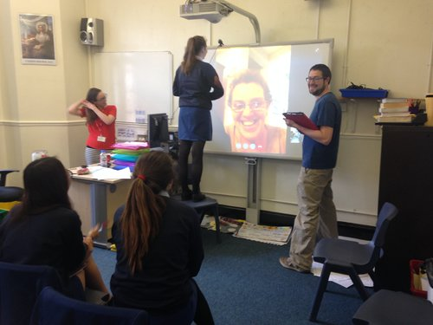

Slide 15
Ideas and approaches
Learning through encounter/experience
Focus on values and tools not issues
Who’s the best person for the job?
Exploring engagement with families

Slide 16
Broker issues
Peace
Green
Development

Slide 17
Ideas and approaches
Learning through encounter/experience
Focus on values and tools not issues
Who’s the best person for the job?
Exploring engagement with families

Slide 18
I recognise you…
Notes:
Welcome

Slide 19
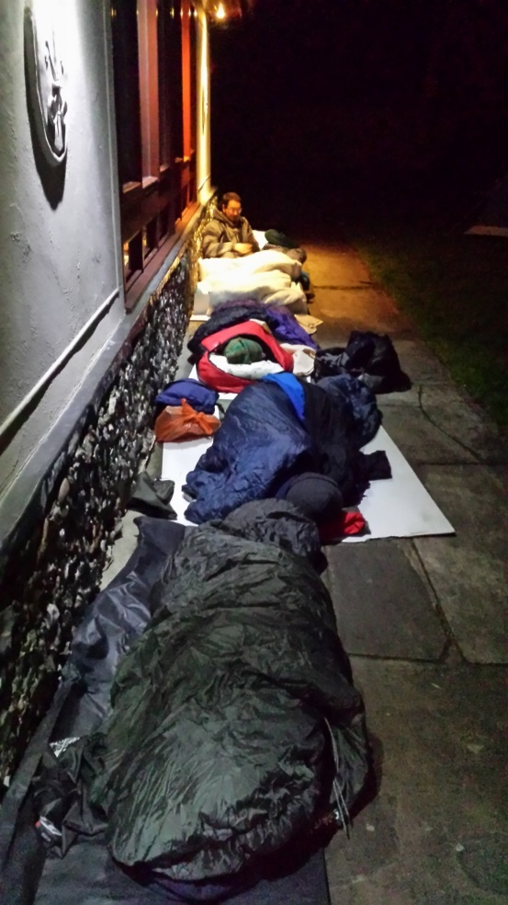
Examples: Prisons, homeless, refugees
Youth worker, sleep out
“I can’t write about what it feels like to lay your head on a pavement every night, or how it feels to have nowhere private to go to the toilet. But I can say that I learned an awful lot. Mainly about how much I don’t know. It was a quiet kind of learning; a brief but sobering education that gently shook my shoulders in a very practical and unassuming kind of way. It has left me with questions, questions about justice, human dignity, charity and statutory responsibility. And it has challenged me to play my small part in campaigning for change.”
Notes:
Say hello to Jesus for me

Slide 20
Examples: Prisons, homeless, refugees
Youth worker, visited refugees with the Columban Lay Missionaries:
“It was particularly eye opening as the women were completely honest about their experiences of detention centres which I hardly knew anything about beforehand. The stories the women shared were shocking. I don’t think I would have ever had the chance to hear their stories in any other situation.”
Teacher, visited Columbans at USA/Mexico border:
“I learned about some of the complexities behind the news and political rhetoric and gained experience and examples to draw upon when challenging the attitudes of people with no experience of the situation and who are heavily influenced in their views by the media.”
Notes:
Say hello to Jesus for me

Slide 21
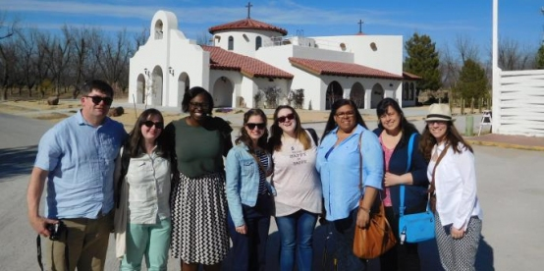
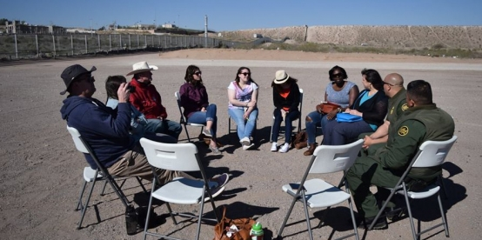
Invitation to Mission Programme
- Deepening an individual’s faith through a cross-cultural encounter with another reality that reveals the face of God - Sharing a wider perspective of God’s mission, including a commitment to justice, peace, creation and inter-religious dialogue as integral to living the Gospel

Slide 22
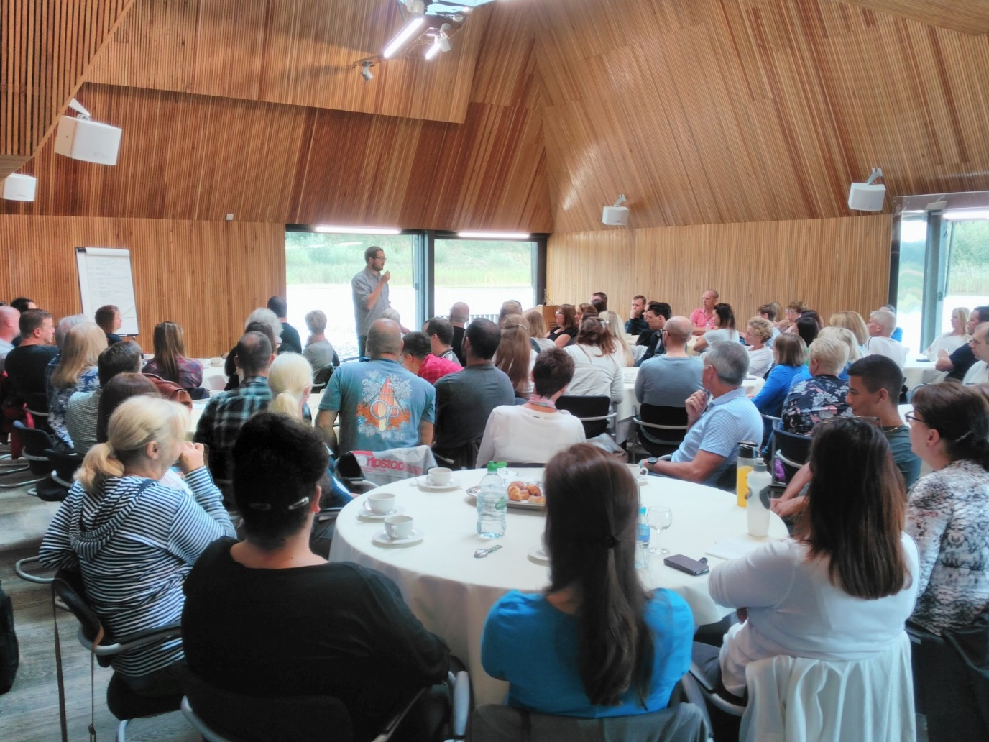
Catholic Spirituality INSET/Retreat

Slide 23
If not me, who?
Notes:
Welcome

Slide 24
Ideas and approaches
Learning through encounter/experience
Focus on values and tools not issues
Who’s the best person for the job?
Exploring engagement with families

Slide 25
JAFFA website
Notes:
Welcome

Slide 28
Many thanks
education@columbans.co.uk

