Slide 1
Diocesan Plan for the Environment
Justice and Peace Assembly 2021

Slide 3
The Archdiocese:
Extends from Stoke in the North to the Thames in the South.
It includes seven cities and five counties; an area with over five million people.
It serves a Catholic population of c. 450,000 through a network of 217 parishes and some 240 schools.
Owns over 1,000 buildings

Slide 4
Statement of Intent
All of Diocesan life and work is to be guided by this document as part of our mission to care for God’s gift of Creation.
We will raise awareness of and become fully educated in the issues concerning the damage being done to God's creation, particularly damage that results in injustice, violence and the life-threatening effects of climate change.
We will judge all decisions against the exhortation in Laudato Si to “hear the cry of the earth and the cry of the poor.” This includes all economic decisions, actions taken as a consumer and investments.
We will support and work with all relevant church agencies, including ecumenical bodies, for the positive environmental change to which we all aspire.
We must all live and practice our faith mindful of the requirement in Catholic Social Teaching to live sustainably.
We will create a Climate Action Group to oversee our work, and aim to establish a wider network of climate campaigners and supporters across the diocese to act as champions in their areas.
We will include our concern for sustainability in our worship and teaching, especially observing Climate Sunday, the Season of Creation and similar significant dates and feasts.
We will undertake an environmental and energy audit of church and school premises and property, identify the most significant issues and impacts which should be addressed and make and implement plans and programmes to tackle them, recognising that some additional costs may be incurred to minimise environmental impacts.
We will work with others in our local community to identify environmental issues which should be addressed in our area and help develop actions to tackle them.

Slide 5
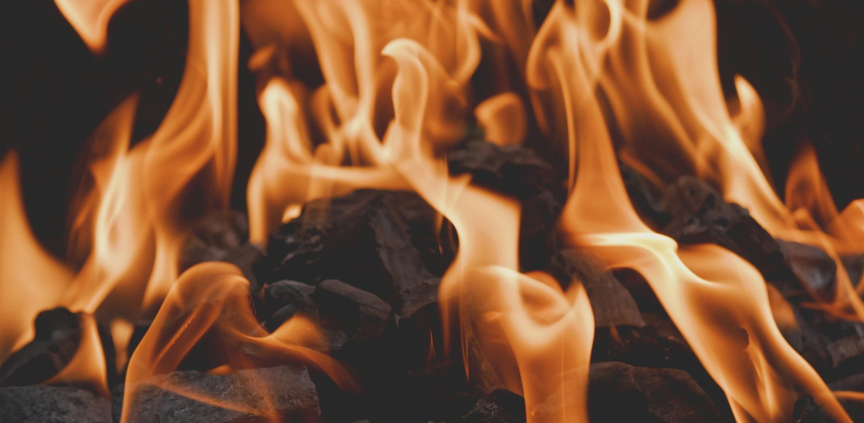
What has been done so far?

Slide 6
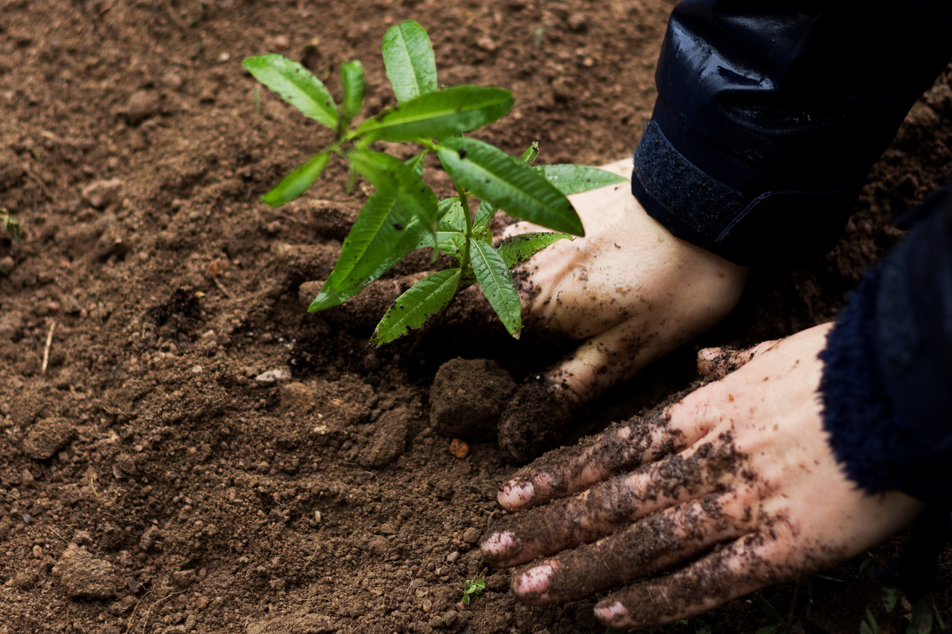
What next?

Slide 7
Milestones 2021
Season of Creation – 1 September - 4 October
Laudato Si’ implementation plans available – 4 October
Vatican meeting. Faith and Science: Toward COP26 – 4 October
Climate Sunday - any Sunday in run up to COP26
Diocesan Climate Action Group formed – October
Trustees review Statement of Intent for climate – October
UN Climate Change Congerence: COP26 - 31 October- 12 November
All Diocesan parishes and schools signed up to livesimply award – target to complete by end of 2021
Deanery reorganisation – complete by end of 2021

Slide 8
What can you do?
Sign up to our climate email list to act as an ambassador or conduit in your community: www.tfaforms.com/4929784
Let us know by 1 October if you are interested in joining the Climate Action steering group- give us any relevant information about your background/experience and passions: climateaction@rcaob.org.uk
Answer some questions in the breakout rooms- answers will be given back to the new climate group.

Slide 9
Breakout Room Questions
What do you hope a Diocesan Climate Action Group could achieve?
What should the Diocesan Climate Action Group’s main priorities be – in the next six months (short term actions)
What should the Diocesan Climate Action Group’s main priorities be – in the longer term (6 months onwards)
How can the Diocesan Climate Action Group help parishes and communities to achieve carbon reductions and care for creation?
How can the Climate Action Group best communicate with and involve parishes, schools and communities?

Slide 10
Diocesan Plan for the Environment
Sign up to our climate email list to act as an ambassador or conduit in your community: www.tfaforms.com/4929784
Let us know by 1 October if you are interested in joining the Climate Action steering group- give us any relevant information about your background/experience and passions: climateaction@rcaob.org.uk

